Slide 1
Electronics of Radio Notes on David Rutledge’s book
John Manferdelli
johnmanferdelli@hotmail.com
09102021 14:12

Slide 2
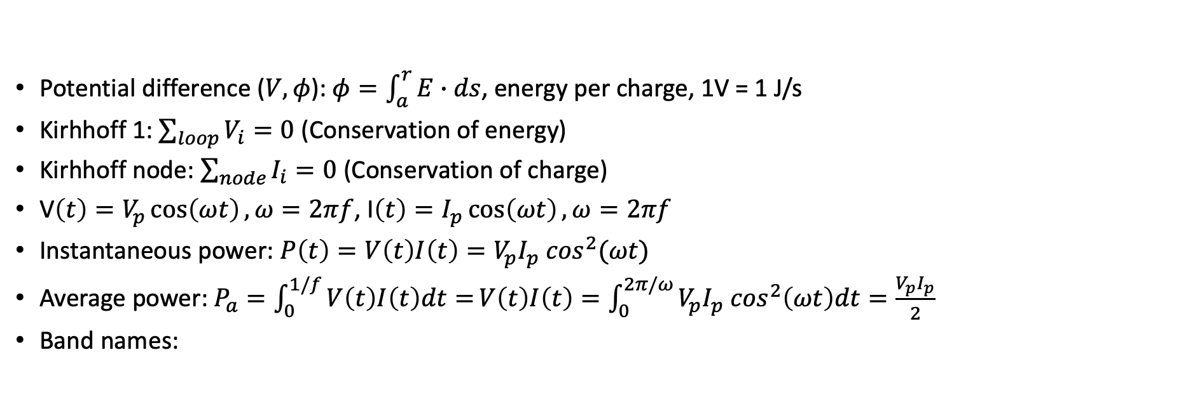
Basic concepts
Potential difference ($V, φ$): $φ=\int_{a}^{r}{E∙ds}$, energy per charge, 1V = 1 J/s
Kirhhoff 1: $\sum_{loop}{V_{i}=0}$ (Conservation of energy)
Kirhhoff node: $\sum_{node}{I_{i}=0}$ (Conservation of charge)
V$\left(t\right)=V_{p}\cos\left(ωt\right), ω=2πf$, I$\left(t\right)=I_{p}\cos\left(ωt\right), ω=2πf$
Instantaneous power: $P\left(t\right)=V\left(t\right)I\left(t\right)=V_{p}I_{p} \cos^{2}(ωt)$
Average power: $P_{a}=\int_{0}^{1/f}{V\left(t\right)I\left(t\right)dt=}V\left(t\right)I\left(t\right)=\int_{0}^{2π/ω}{V_{p}I_{p} \cos^{2}\left(ωt\right)dt}=\frac{V_{p}I_{p}}{2}$
Band names:
Name | Frequency
VLF | 3-30kHz
LW | 20-300kHz
MW | 300kHz-3MHz
HF | 3MHz-30MHz
VHF | 30-300MHz
Name | Frequency
UHF | 300MHz-1GHz
uW | 1-30GHz
milliW | 30-300GHz
submilliF | >300GHz

Slide 3
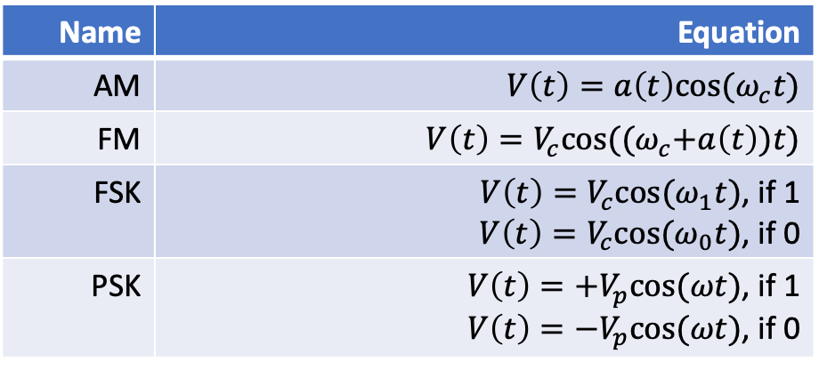
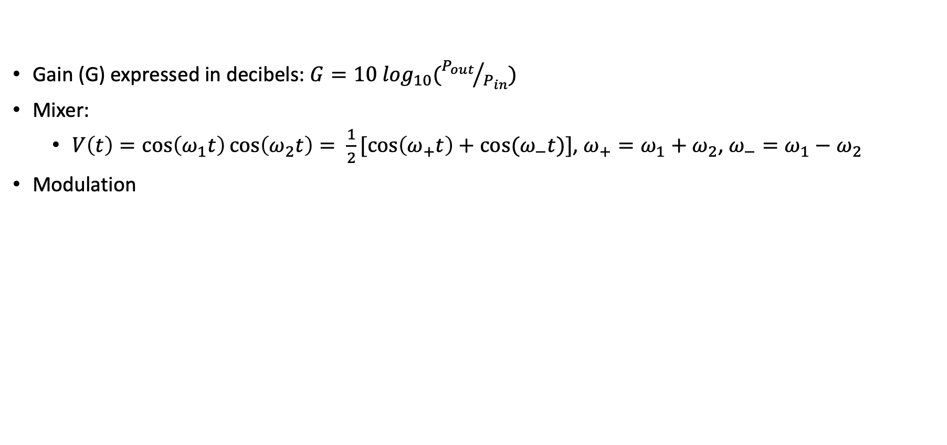
Signals
Gain (G) expressed in decibels: $G=10 \log_{10}({P_{out}}/{P_{in}})$
Mixer:
$V\left(t\right)=\cos\left(ω_{1}t\right)\cos\left(ω_{2}t\right)= \frac{1}{2}[\cos\left(ω_{+}t\right)+cos⁡(ω_{−}t)]$, $ω_{+}=ω_{1}+ω_{2}$, $ω_{−}=ω_{1}−ω_{2}$
Modulation
Name | Equation
AM | $$V\left(t\right)=a\left(t\right)cos⁡(ω_{c}t)$$
FM | $$V\left(t\right)=V_{c}cos⁡({(ω}_{c}+a\left(t\right))t)$$
FSK | $V\left(t\right)=V_{c}cos⁡(ω_{1}t)$, if 1 $V\left(t\right)=V_{c}cos⁡(ω_{0}t)$, if 0
PSK | $V\left(t\right)={+V}_{p}cos⁡(ωt)$, if 1 $V\left(t\right)=−V_{p}cos⁡(ωt)$, if 0

Slide 4



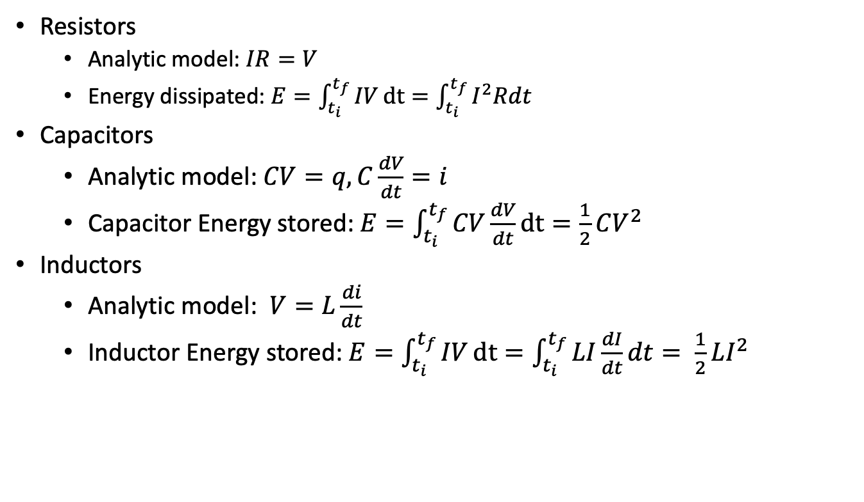
Resistors, capacitors, inductors
Resistors
Analytic model: $IR=V$
Energy dissipated: $E=\int_{t_{i}}^{t_{f}}{IV}dt=\int_{t_{i}}^{t_{f}}{I^{2}Rdt}$
Capacitors
Analytic model: $CV=q, C\frac{dV}{dt}=i$
Capacitor Energy stored: $E=\int_{t_{i}}^{t_{f}}{CV\frac{dV}{dt}}dt=\frac{1}{2}CV^{2}$
Inductors
Analytic model: $V=L\frac{di}{dt}$
Inductor Energy stored: $E=\int_{t_{i}}^{t_{f}}{IV}dt=\int_{t_{i}}^{t_{f}}{LI\frac{dI}{dt}dt= \frac{1}{2}LI^{2}}$
R
Credit: Make Electronics

Slide 5

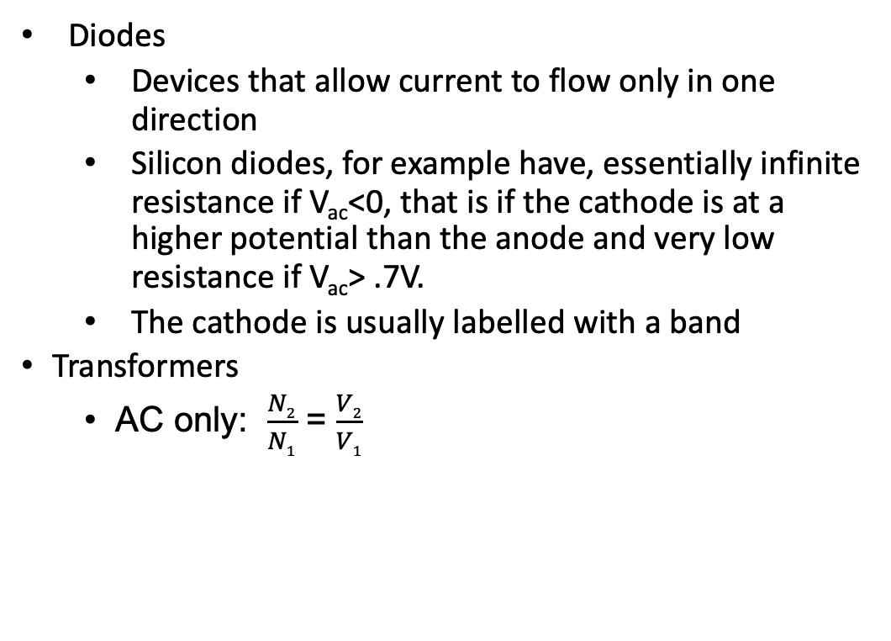
Diodes, transformers
Diodes
Devices that allow current to flow only in one direction
Silicon diodes, for example have, essentially infinite resistance if V_{ac}<0, that is if the cathode is at a higher potential than the anode and very low resistance if V_{ac}> .7V.
The cathode is usually labelled with a band
Transformers
AC only: $\frac{N2}{N1}$ = $\frac{V2}{V1}$
Credit: Make Electronics

Slide 6
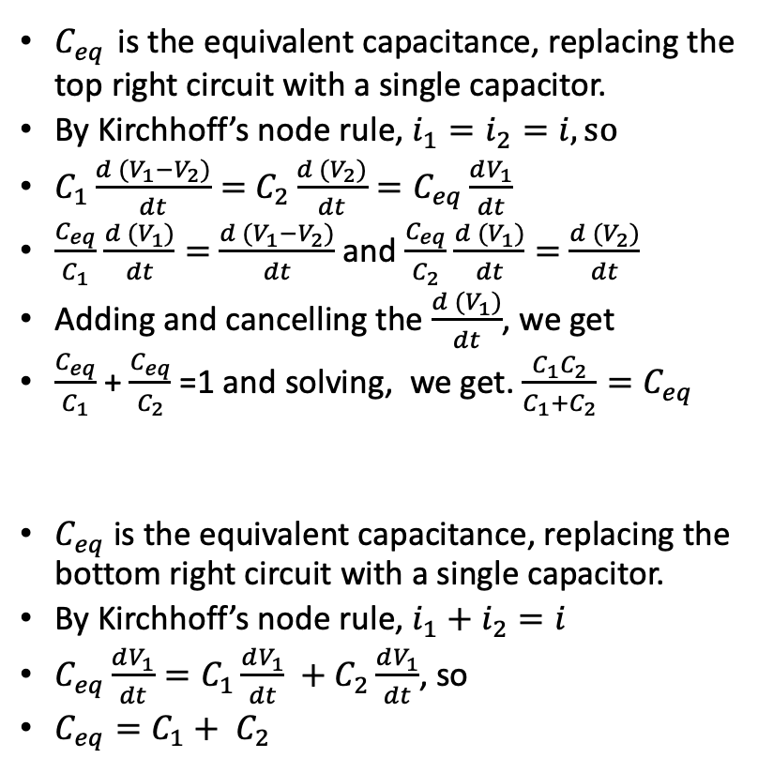
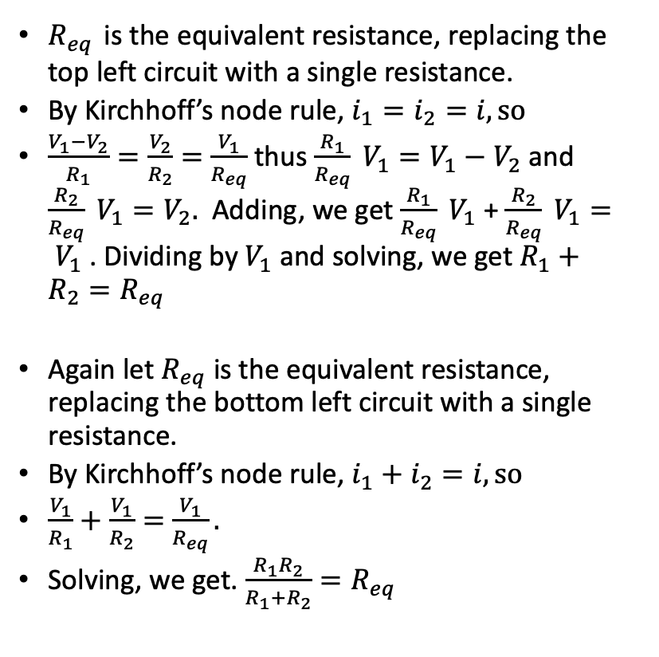
Simple circuit analysis with Kirchhoff
$R_{eq}$ is the equivalent resistance, replacing the top left circuit with a single resistance.
By Kirchhoff’s node rule, $i_{1}=i_{2}=i, so$
$\frac{V_{1}−V_{2}}{R_{1}}=\frac{V_{2}}{R_{2}}=$ $\frac{V_{1}}{R_{eq}}$ thus $\frac{R_{1}}{R_{eq}} V_{1}=V_{1}−V_{2}$ and $\frac{R_{2}}{R_{eq}} V_{1}=V_{2}.$ Adding, we get $\frac{R_{1}}{R_{eq}} V_{1}$ + $\frac{R_{2}}{R_{eq}} V_{1}= V_{1}$ . Dividing by $V_{1}$ and solving, we get $R_{1}+R_{2}=R_{eq}$
Again let $R_{eq}$ is the equivalent resistance, replacing the bottom left circuit with a single resistance.
By Kirchhoff’s node rule, $i_{1}+i_{2}=i, so$
$\frac{V_{1}}{R_{1}}+\frac{V_{1}}{R_{2}}=$ $\frac{V_{1}}{R_{eq}}.$
Solving, we get. $\frac{R_{1}R_{2}}{R_{1}+R_{2}}=R_{eq}$
$C_{eq}$ is the equivalent capacitance, replacing the top right circuit with a single capacitor.
By Kirchhoff’s node rule, $i_{1}=i_{2}=i, so$
$C_{1}\frac{d (V_{1}−V_{2})}{dt}=$ $C_{2}\frac{d (V_{2})}{dt}=C_{eq}\frac{dV_{1}}{dt}$
$\frac{C_{eq}}{C_{1}}$ $\frac{d (V_{1})}{dt}=$ $\frac{d (V_{1}−V_{2})}{dt}$ and $\frac{C_{eq}}{C_{2}}$ $\frac{d (V_{1})}{dt}=$ $\frac{d (V_{2})}{dt}$
Adding and cancelling the $\frac{d (V_{1})}{dt}$, we get
$\frac{C_{eq}}{C_{1}}$ + $\frac{C_{eq}}{C_{2}}$ =1 and solving, we get. $\frac{C_{1}C_{2}}{C_{1}+C_{2}}=C_{eq}$
$C_{eq}$ is the equivalent capacitance, replacing the bottom right circuit with a single capacitor.
By Kirchhoff’s node rule, $i_{1}+i_{2}=i$
$C_{eq}\frac{dV_{1}}{dt}=C_{1}\frac{dV_{1}}{dt} +C_{2}\frac{dV_{1}}{dt}$, so
$C_{eq}=C_{1}+ C_{2}$
V₁
V₁
R₁
i₁
C₁
i₁
i
i
V₂
V₂
R₂
i₂
C₂
i₂
V=0
V=0
V₁
i
R₁
i₁
V₁
R₂
i₂
i
C₁
i₁
C₂
i₂
V=0
V=0

Slide 7
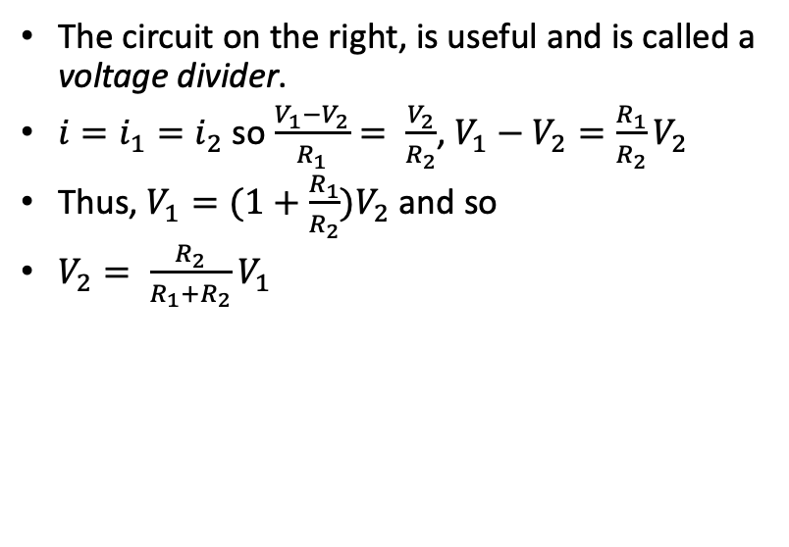
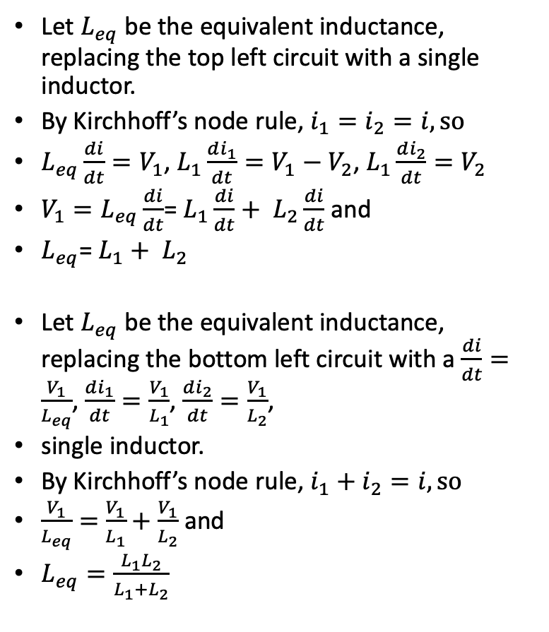
Simple circuit analysis with Kirchhoff
V₁
Let $L_{eq}$ be the equivalent inductance, replacing the top left circuit with a single inductor.
By Kirchhoff’s node rule, $i_{1}=i_{2}=i, so$
$L_{eq}\frac{di}{dt}=V_{1}$, $L_{1}\frac{di_{1}}{dt}=V_{1}−V_{2}$, $L_{1}\frac{di_{2}}{dt}=V_{2}$
${V_{1}=L}_{eq}\frac{di}{dt}$= $L_{1}\frac{di}{dt}+ L_{2}\frac{di}{dt}$ and
$L_{eq}$= $L_{1}+ L_{2}$
Let $L_{eq}$ be the equivalent inductance, replacing the bottom left circuit with a $\frac{di}{dt}=\frac{V_{1}}{L_{eq}}$, $\frac{di_{1}}{dt}=\frac{V_{1}}{L_{1}}$, $\frac{di_{2}}{dt}=\frac{V_{1}}{L_{2}}$,
single inductor.
By Kirchhoff’s node rule, $i_{1}+i_{2}=i, so$
$\frac{V_{1}}{L_{eq}}=$ $\frac{V_{1}}{L_{1}}+\frac{V_{1}}{L_{2}}$ and
$L_{eq}=\frac{L_{1}L_{2}}{L_{1}+L_{2}}$
L₁
i₁
i
V₂
L₂
i₂
The circuit on the right, is useful and is called a voltage divider.
$i=i_{1}=i_{2}$ so $\frac{V_{1}−V_{2}}{R_{1}}= \frac{V_{2}}{R_{2}}$, $V_{1}−V_{2}=\frac{R_{1}}{R_{2}}V_{2}$
Thus, $V_{1}=(1+\frac{R_{1}}{R_{2}})V_{2}$ and so
$V_{2}= \frac{R_{2}}{R_{1}+R_{2}}V_{1}$
V=0
V₁
R₁
i₁
i
V₁
V₂
R₂
i₂
i
L₁
L₂
V=0
i₁
i₂
V=0

Slide 8


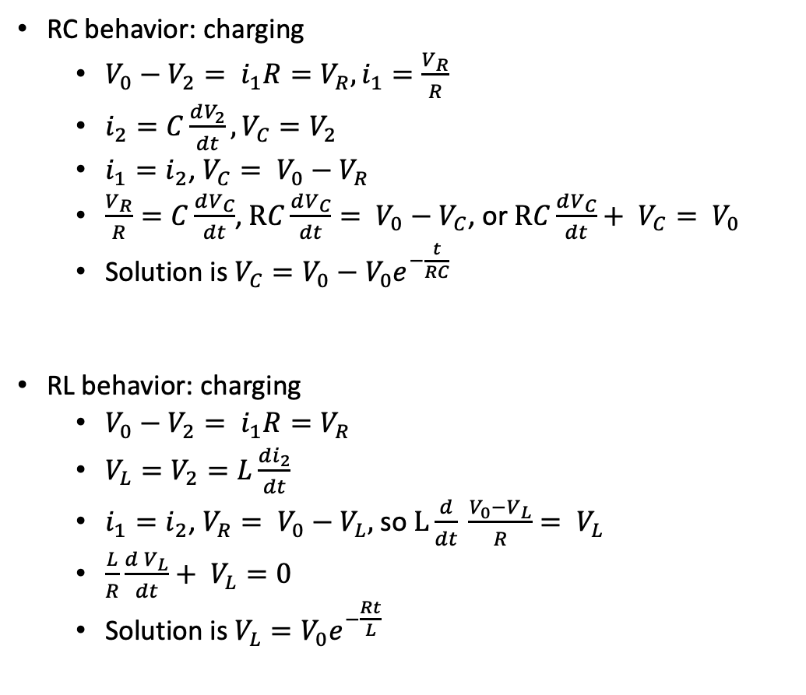
RC/RL circuit analysis with Kirchhoff
RC behavior: charging
$V_{0}−V_{2}= i_{1}R=V_{R}, i_{1}=\frac{V_{R}}{R}$
$i_{2}=C\frac{dV_{2}}{dt},V_{C}=V_{2}$
$i_{1}=i_{2}$, $V_{C}= V_{0}−V_{R}$
$\frac{V_{R}}{R}=C\frac{dV_{C}}{dt}$,$RC\frac{dV_{C}}{dt}= V_{0}−V_{C}$, or $RC\frac{dV_{C}}{dt}+ V_{C}= V_{0}$
Solution is $V_{C}=V_{0}−V_{0}e^{−\frac{t}{RC}}$
RL behavior: charging
$V_{0}−V_{2}= i_{1}R=V_{R}$
$V_{L}=V_{2}=L\frac{di_{2}}{dt}$
$i_{1}=i_{2}$, $V_{R}= V_{0}−V_{L},$ so $L\frac{d}{dt} \frac{V_{0}−V_{L}}{R}= V_{L}$
$\frac{L}{R}\frac{d V_{L}}{dt}+ V_{L}=0$
Solution is $V_{L}=V_{0}e^{−\frac{Rt}{L}}$
V₀
R
i₁
+
V₂
-
C
i₂
V₀
R
i₁
+
V₂
-
L
i₂
C₂

Slide 9
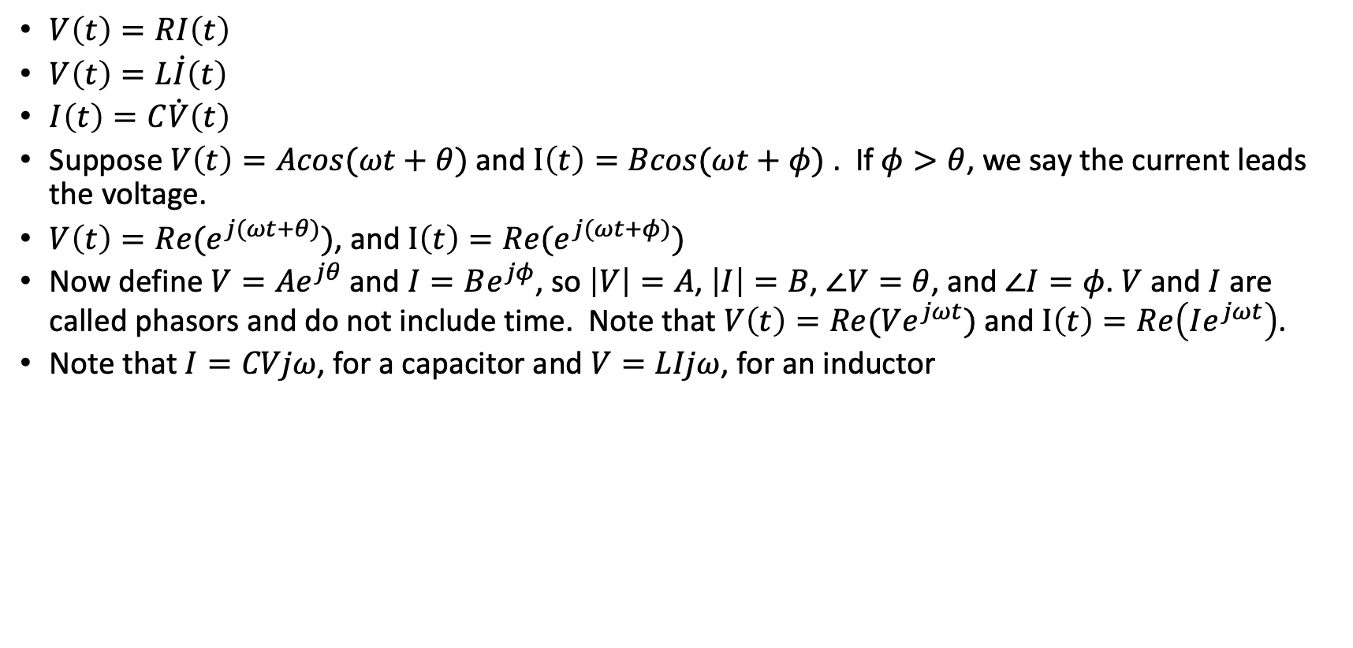
Phasors
$V\left(t\right)=RI\left(t\right)$
$V\left(t\right)=L\dot{I}\left(t\right)$
$I\left(t\right)=C\dot{V}\left(t\right)$
Suppose $V\left(t\right)=Acos(ωt+θ)$ and $I\left(t\right)=Bcos(ωt+φ)$ . If $φ>θ$, we say the current leads the voltage.
$V\left(t\right)=Re(e^{j(ωt+θ)})$, and $I\left(t\right)=Re(e^{j(ωt+φ)})$
Now define $V=Ae^{jθ}$ and $I=Be^{jφ}$, so $\left|V\right|=A$, $\left|I\right|=B$, $∠V=θ$, and $∠I=φ$. $V$ and $I$ are called phasors and do not include time. Note that $V\left(t\right)=Re(Ve^{jωt})$ and $I\left(t\right)=Re\left(Ie^{jωt}\right)$.
Note that $I=CVjω$, for a capacitor and $V=LIjω$, for an inductor

Slide 10
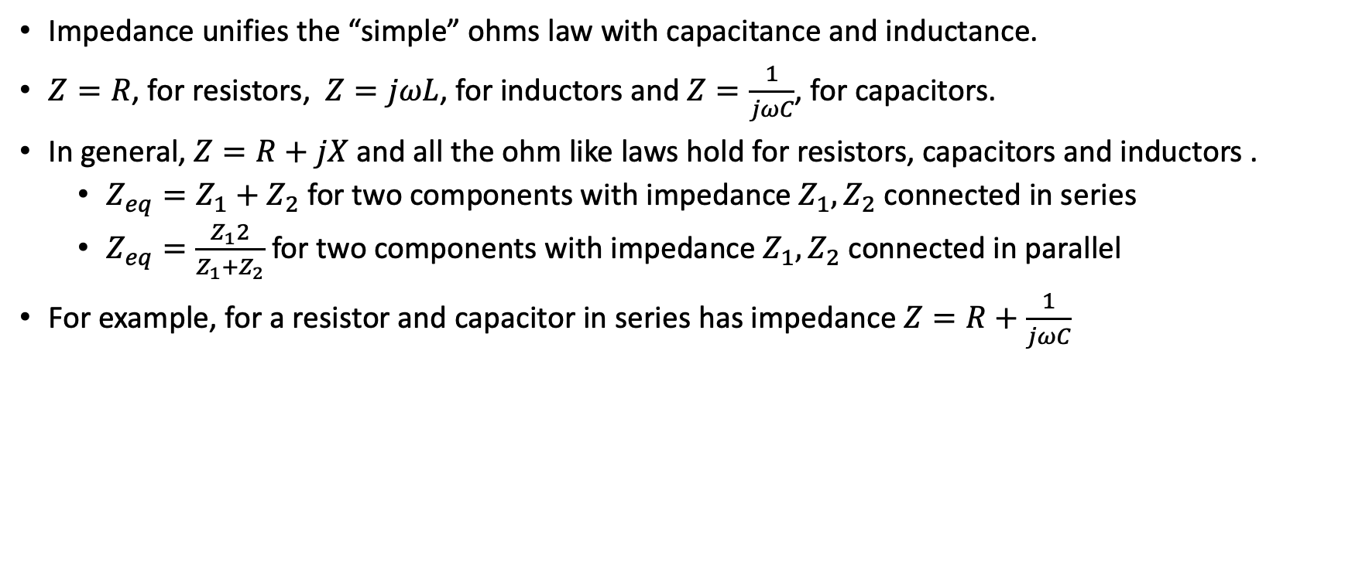
Circuit analysis and impedance
Impedance unifies the “simple” ohms law with capacitance and inductance.
$Z=R$, for resistors, $Z=jωL$, for inductors and $Z=\frac{1}{jωC}$, for capacitors.
In general, $Z=R+jX$ and all the ohm like laws hold for resistors, capacitors and inductors .
$Z_{eq}=Z_{1}+Z_{2}$ for two components with impedance $Z_{1}, Z_{2}$ connected in series
$Z_{eq}=\frac{Z_{1}2}{Z_{1}+Z_{2}}$ for two components with impedance $Z_{1}, Z_{2}$ connected in parallel
For example, for a resistor and capacitor in series has impedance $Z=R+\frac{1}{jωC}$

Slide 11
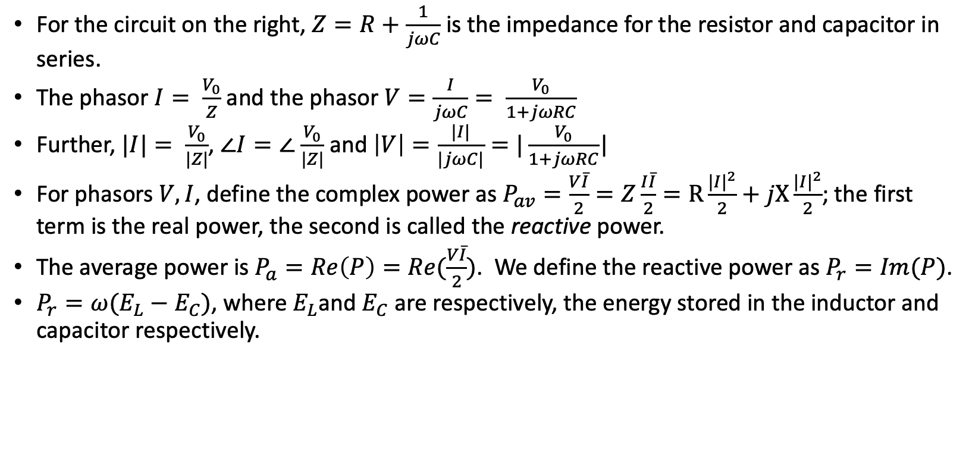
Phasors, impedance and power
For the circuit on the right, $Z=R+\frac{1}{jωC}$ is the impedance for the resistor and capacitor in series.
The phasor $I= \frac{V_{0}}{Z}$ and the phasor $V=\frac{I}{jωC}= \frac{V_{0}}{1+jωRC}$
Further, $|I|= \frac{V_{0}}{|Z|}$, $∠I=∠$ $\frac{V_{0}}{|Z|}$ and $\left|V\right|=\frac{|I|}{|jωC|}=|\frac{V_{0}}{1+jωRC}$|
For phasors $V,I$, define the complex power as $P_{av}=\frac{V\overline{I}}{2}=Z\frac{I\overline{I}}{2}=R\frac{{|I|}^{2}}{2}+jX\frac{{|I|}^{2}}{2}$; the first term is the real power, the second is called the reactive power.
The average power is $P_{a}=Re\left(P\right)=Re(\frac{V\overline{I}}{2})$. We define the reactive power as $P_{r}=Im(P)$.
$P_{r}=ω(E_{L}−E_{C})$, where $E_{L}$and $E_{C}$ are respectively, the energy stored in the inductor and capacitor respectively.
R
V₀
C
I
V

Slide 12
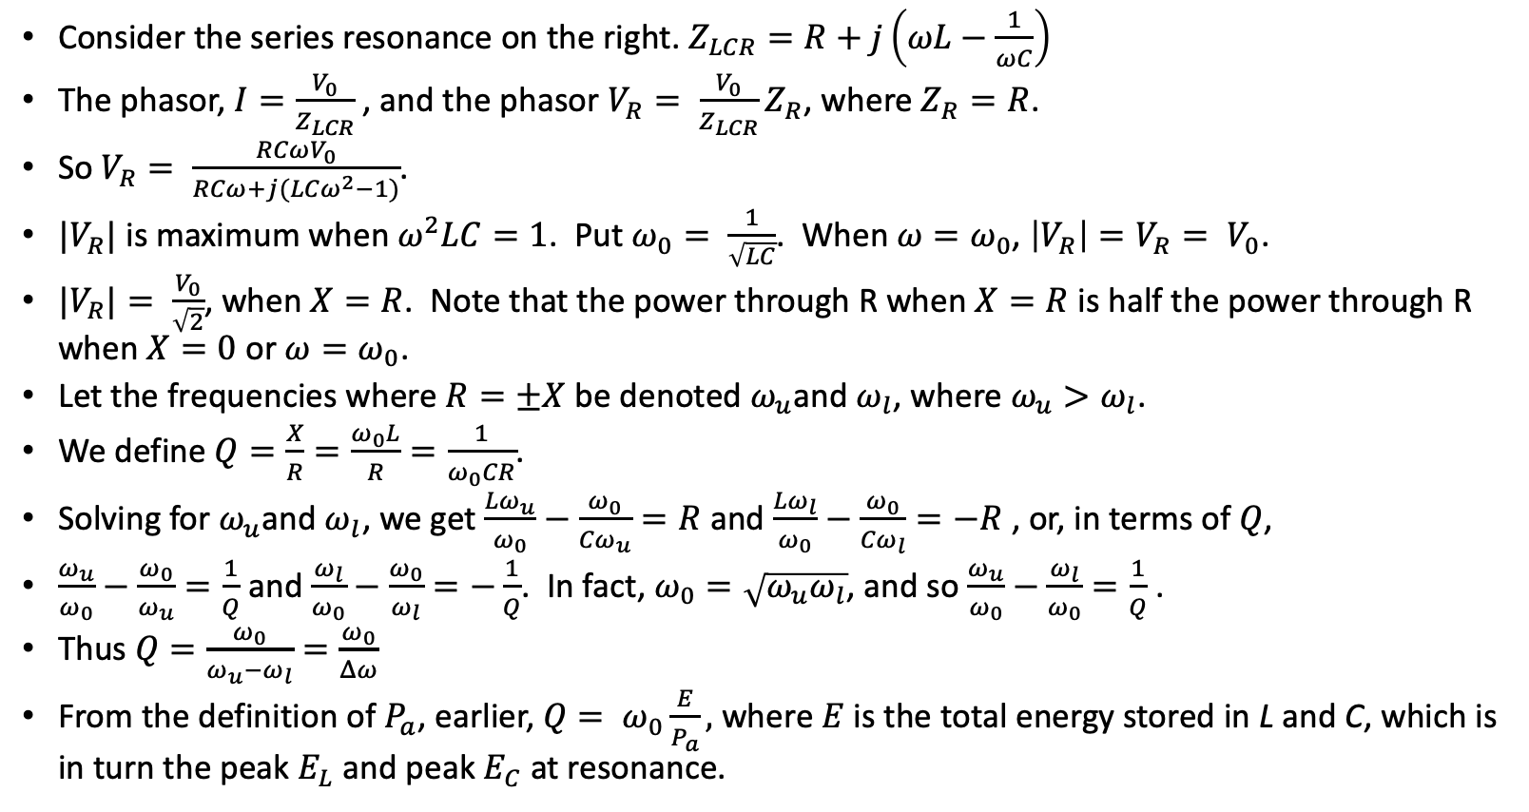
Q and phasors
L
Consider the series resonance on the right. $Z_{LCR}=R+j\left(ωL−\frac{1}{ωC}\right)$
The phasor, $I=\frac{V_{0}}{Z_{LCR}}$, and the phasor $V_{R}= \frac{V_{0}}{Z_{LCR}}Z_{R}$, where $Z_{R}=R$.
So $V_{R}= \frac{RCωV_{0}}{RCω+j({LCω}^{2}−1)}$.
$|V_{R}|$ is maximum when$ω^{2}LC=1$. Put $ω_{0}= \frac{1}{\sqrt{LC}}$. When $ω=ω_{0}$, $\left|V_{R}\right|=V_{R}= V_{0}$.
${|V}_{R}|= \frac{V_{0}}{\sqrt{2}}$, when $X=R$. Note that the power through R when $X=R$ is half the power through R when $X=0$ or $ω=ω_{0}$.
Let the frequencies where $R=±X$ be denoted $ω_{u}$and $ω_{l}$, where $ω_{u}>ω_{l}$.
We define $Q=\frac{X}{R}=\frac{ω_{0}L}{R}=\frac{1}{ω_{0}CR}$.
Solving for $ω_{u}$and $ω_{l}$, we get $\frac{{Lω}_{u}}{ω_{0}}−\frac{ω_{0}}{{Cω}_{u}}=R$ and $\frac{{Lω}_{l}}{ω_{0}}−\frac{ω_{0}}{{Cω}_{l}}=−R$ , or, in terms of $Q$,
$\frac{ω_{u}}{ω_{0}}−\frac{ω_{0}}{ω_{u}}=\frac{1}{Q}$ and $\frac{ω_{l}}{ω_{0}}−\frac{ω_{0}}{ω_{l}}=−\frac{1}{Q}$. In fact, $ω_{0}=\sqrt{ω_{u}ω_{l}}$, and so $\frac{ω_{u}}{ω_{0}}−\frac{ω_{l}}{ω_{0}}=\frac{1}{Q}$ .
Thus $Q=\frac{ω_{0}}{ω_{u}−ω_{l}}=\frac{ω_{0}}{Δω}$
From the definition of $P_{a}$, earlier, $Q= ω_{0}\frac{E}{P_{a}},$ where $E$ is the total energy stored in L and C, which is in turn the peak $E_{L}$ and peak $E_{C}$ at resonance.
C
V₀
R
V_{R}

Slide 13
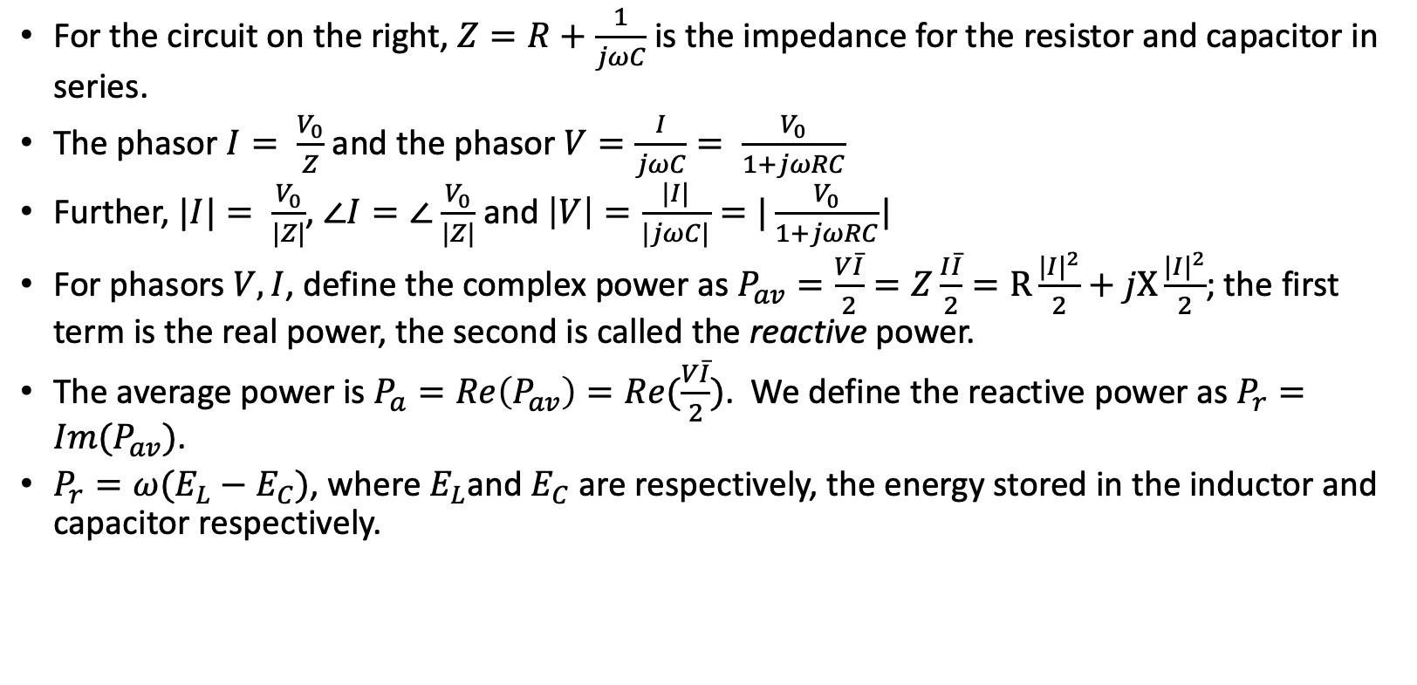
Phasors, impedance and power
For the circuit on the right, $Z=R+\frac{1}{jωC}$ is the impedance for the resistor and capacitor in series.
The phasor $I= \frac{V_{0}}{Z}$ and the phasor $V=\frac{I}{jωC}= \frac{V_{0}}{1+jωRC}$
Further, $|I|= \frac{V_{0}}{|Z|}$, $∠I=∠$ $\frac{V_{0}}{|Z|}$ and $\left|V\right|=\frac{|I|}{|jωC|}=|\frac{V_{0}}{1+jωRC}$|
For phasors $V,I$, define the complex power as $P_{av}=\frac{V\overline{I}}{2}=Z\frac{I\overline{I}}{2}=R\frac{{|I|}^{2}}{2}+jX\frac{{|I|}^{2}}{2}$; the first term is the real power, the second is called the reactive power.
The average power is $P_{a}=Re\left(P_{av}\right)=Re(\frac{V\overline{I}}{2})$. We define the reactive power as $P_{r}=Im(P_{av})$.
$P_{r}=ω(E_{L}−E_{C})$, where $E_{L}$and $E_{C}$ are respectively, the energy stored in the inductor and capacitor respectively.
R
V₀
C
I
V

Slide 14
Thevenin and Norton
Thevenin: Any combination of linear sources and passive elements terminating in two terminals is equivalent to a pure voltage source in series with an impedance
Norton: Any combination of linear sources and passive elements terminating in two terminals is equivalent to a pure current source in parallel with a conductance
Similar theorems for two terminal input and output devices (with transfer function)
Z_{Th}
V_{Th}
I_{N}
G_{Th}

Slide 15
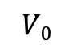
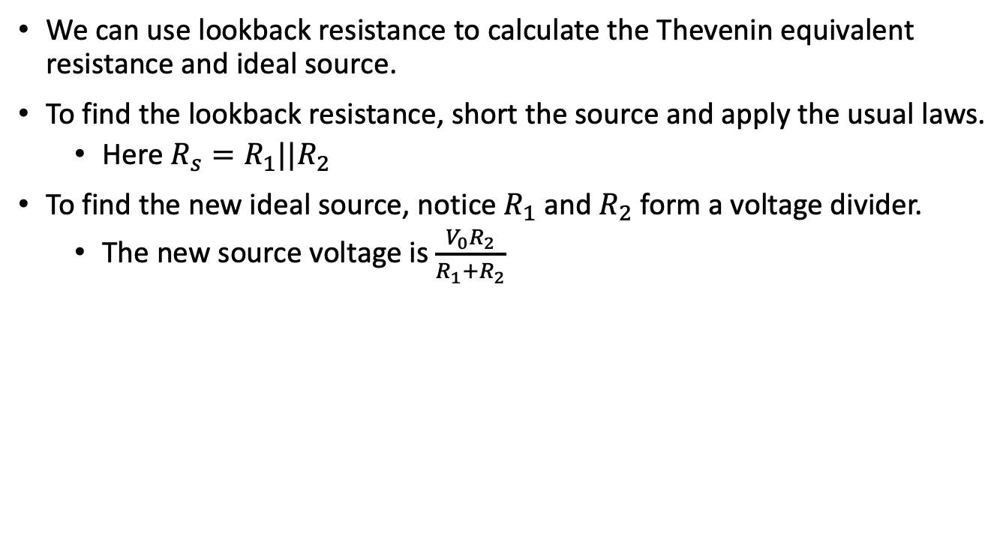
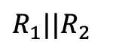
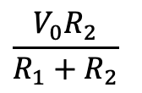
Thevenin and Norton
We can use lookback resistance to calculate the Thevenin equivalent resistance and ideal source.
To find the lookback resistance, short the source and apply the usual laws.
Here $R_{s}=R_{1}||R_{2}$
To find the new ideal source, notice $R_{1}$ and $R_{2}$ form a voltage divider.
The new source voltage is $\frac{V_{0}R_{2}}{R_{1}+R_{2}}$
R₁
$$V0$$
R₂
is equivalent to
$$R_{1}||R_{2}$$
$$\frac{V_{0}R_{2}}{R_{1}+R_{2}}$$

Slide 16
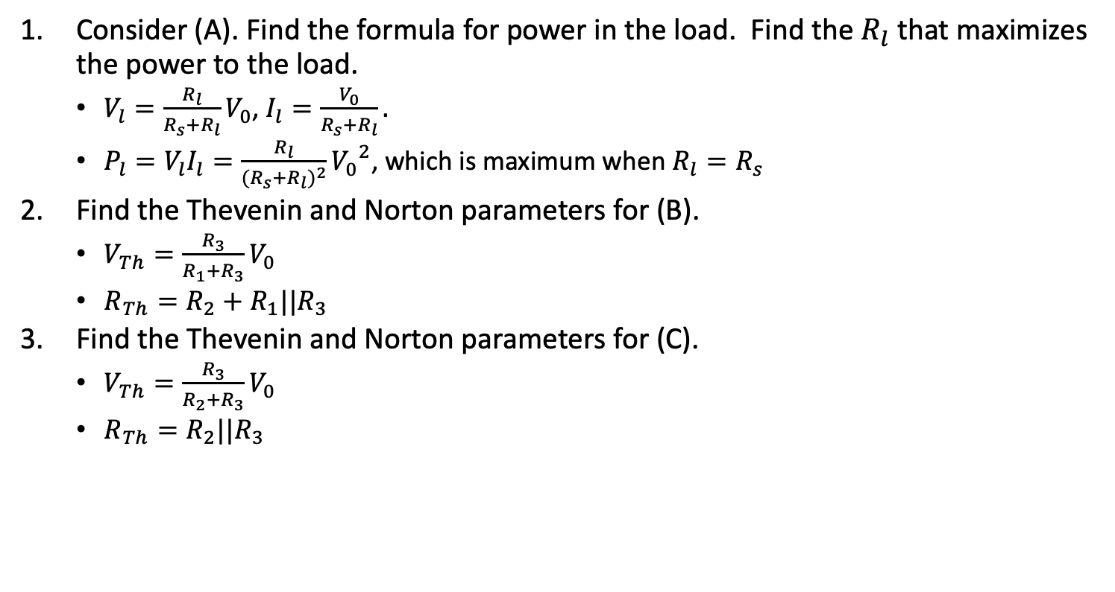
Exercise 1: Resistors
R_{s}
V_{l}
+
A
Consider (A). Find the formula for power in the load. Find the $R_{l}$ that maximizes the power to the load.
$V_{l}=\frac{R_{l}}{R_{s}+R_{l}}V_{0}$, $I_{l}=\frac{V_{0}}{R_{s}+R_{l}}.$
$P_{l}=V_{l}I_{l}=\frac{R_{l}}{{(R_{s}+R_{l})}^{2}}{V_{0}}^{2}$, which is maximum when $R_{l}=R_{s}$
Find the Thevenin and Norton parameters for (B).
$V_{Th}=\frac{R_{3}}{R_{1}+R_{3}}V_{0}$
$R_{Th}=R_{2}+R_{1}||R_{3}$
Find the Thevenin and Norton parameters for (C).
$V_{Th}=\frac{R_{3}}{R_{2}+R_{3}}V_{0}$
$R_{Th}=R_{2}||R_{3}$
V₀
-
R_{l}
R₁
R₂
+
R₃
V₀
B
-
R₂
+
R₁
R₃
V₀
C
-

Slide 17
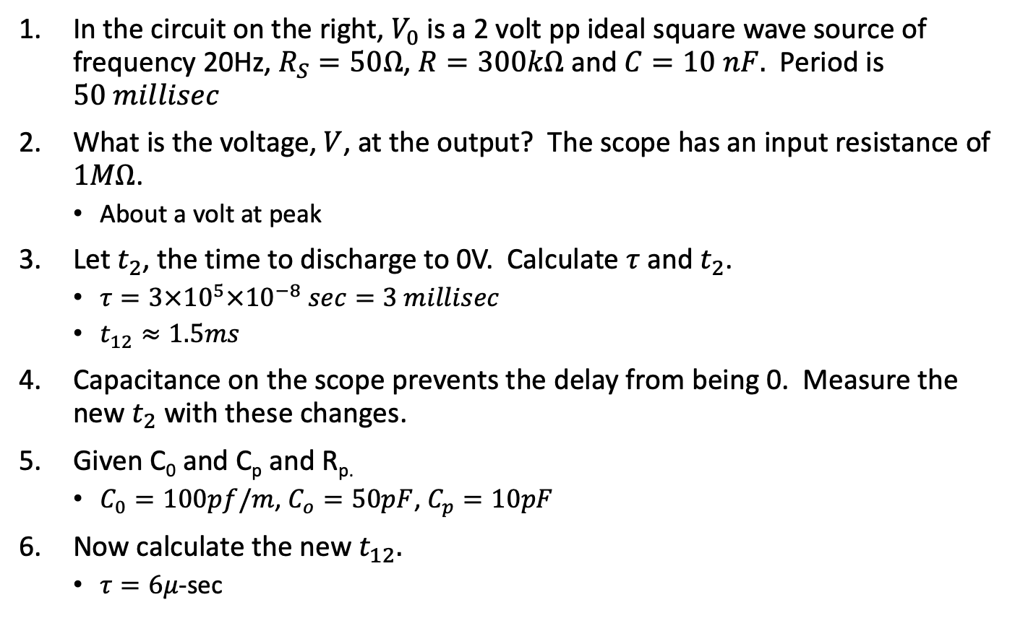
Exercise 3: Capacitors
In the circuit on the right, $V_{0}$ is a 2 volt pp ideal square wave source of frequency 20Hz, $R_{S}=50Ω$, $R=300kΩ$ and $C=10 nF.$ Period is $50 millisec$
What is the voltage, $V$, at the output? The scope has an input resistance of $1MΩ$.
About a volt at peak
Let $t_{2}$, the time to discharge to 0V. Calculate $τ$ and $t_{2}$.
$τ=3×{10}^{5}×{10}^{−8} sec=3 millisec$
$t_{12}≈1.5ms$
Capacitance on the scope prevents the delay from being 0. Measure the new $t_{2}$ with these changes.
Given C₀ and C_{p} and R_{p.}
$C_{0}=100pf/m$, $C_{o}=50pF$, $C_{p}=10pF$
Now calculate the new $t_{12}.$
$τ=6μ$-sec
R_{s}
R
C
V
V₀
Probe
R_{p}
C_{c}
V
V_{i}
C_{p}
C_{o}
R₀

Slide 18
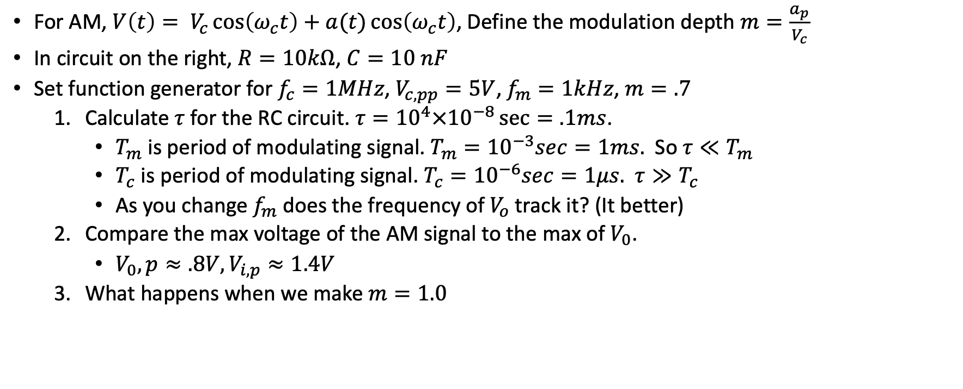
Exercise 4: Diode detectors
V_{i}
R
C
V_{o}
For AM, $V\left(t\right)= V_{c}\cos\left(ω_{c}t\right)+a(t)\cos\left(ω_{c}t\right)$, Define the modulation depth $m=\frac{a_{p}}{V_{c}}$
In circuit on the right, $R=10kΩ$, $C=10 nF$
Set function generator for $f_{c}=1MHz$, $V_{c,pp}=5V$, $f_{m}=1kHz$, $m=.7$
Calculate $τ$ for the RC circuit. $τ={10}^{4}×{10}^{−8}\sec{=.1ms}$.
$T_{m}$ is period of modulating signal. $T_{m}={10}^{−3}sec=1ms.$ So $τ≪T_{m}$
$T_{c}$ is period of modulating signal. $T_{c}={10}^{−6}sec=1μs.$ $τ≫T_{c}$
As you change $f_{m}$ does the frequency of $V_{o}$ track it? (It better)
Compare the max voltage of the AM signal to the max of $V_{0}$.
$V_{0},p≈.8V, V_{i,p}≈1.4V$
What happens when we make $m=1.0$

Slide 19
AM Modulator for previous exercise
12V
I didn’t have a signal generator that produced an AM signal, so I used the modulator on the right with the indicated inputs to produce the AM needed for the detector in the previous exercise.
47k
10k
.1uF
.1uF
Carrier signal
.8 Vpp, 1MHz
2.2k
10k
680
1nF
Modulation signal
4.2 V_{pp}, 1kHz

Slide 20
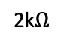
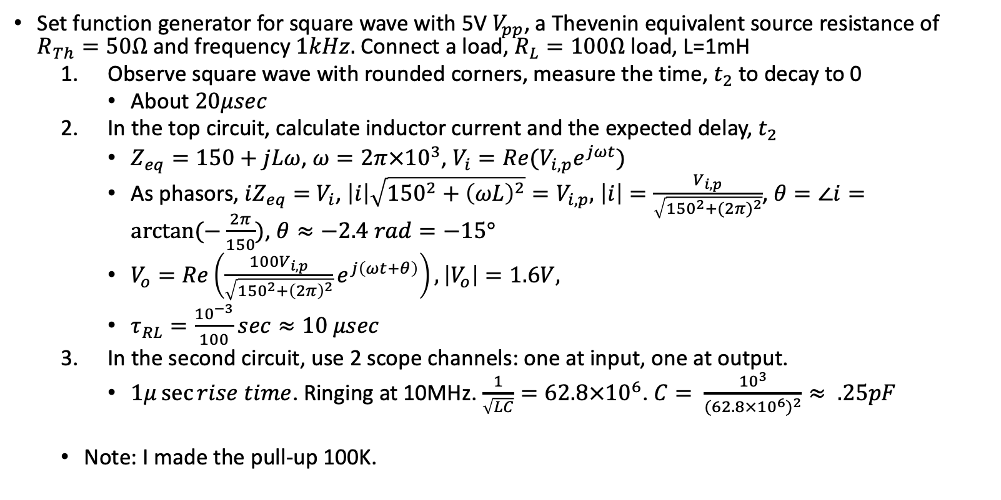
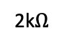
Exercise 5: Inductors
Set function generator for square wave with 5V $V_{pp}$, a Thevenin equivalent source resistance of $R_{Th}=50Ω$ and frequency $1kHz.$ Connect a load, $R_{L}=100Ω$ load, L=1mH
Observe square wave with rounded corners, measure the time, $t_{2}$ to decay to 0
About $20μsec$
In the top circuit, calculate inductor current and the expected delay, $t_{2}$
$Z_{eq}=150+jLω$, $ω=2π{×10}^{3}$, $V_{i}={Re(V}_{i,p}e^{jωt})$
As phasors, $iZ_{eq}=$ $V_{i}$, $\left|i\right|\sqrt{{150}^{2}+{\left(ωL\right)}^{2}}=V_{i,p},$ $\left|i\right|=\frac{V_{i,p}}{\sqrt{{150}^{2}+{(2π)}^{2}}}$, $θ=∠i=arctan⁡(−\frac{2π}{150})$, $θ≈−2.4 rad=−15°$
$V_{o}=Re\left(\frac{100V_{i,p}}{\sqrt{{150}^{2}+{\left(2π\right)}^{2}}}e^{j\left(ωt+θ\right)}\right), \left|V_{o}\right|=1.6V,$
$τ_{RL}=\frac{{10}^{−3}}{100}sec≈10 μsec$
In the second circuit, use 2 scope channels: one at input, one at output.
$1μ\sec{rise time}$. Ringing at 10MHz. $\frac{1}{\sqrt{LC}}=62.8×{10}^{6}$. $C= \frac{{10}^{3}}{{(62.8×{10}^{6})}^{2}}≈ .25pF$
Note: I made the pull-up 100K.
R_{Th}
L
V_{i}
R_{L}
V_{o}
12V
L
2k$Ω$
2N2222A
out
2k$Ω$

Slide 21
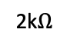
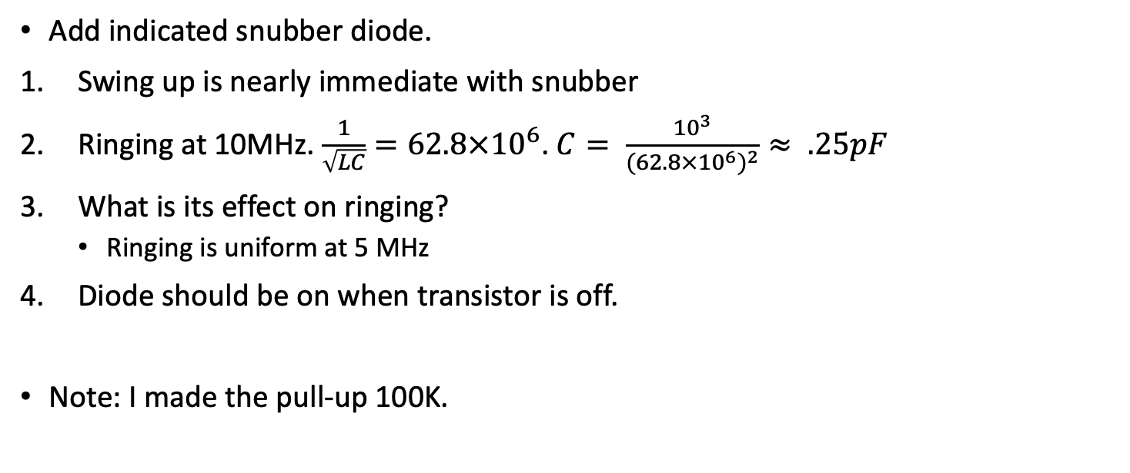
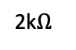
Exercise 6: Diodes and snubbers
Add indicated snubber diode.
Swing up is nearly immediate with snubber
Ringing at 10MHz. $\frac{1}{\sqrt{LC}}=62.8×{10}^{6}$. $C= \frac{{10}^{3}}{{(62.8×{10}^{6})}^{2}}≈ .25pF$
What is its effect on ringing?
Ringing is uniform at 5 MHz
Diode should be on when transistor is off.
Note: I made the pull-up 100K.
12 V
L
2k$Ω$
2N2222A
out
2k$Ω$

Slide 22
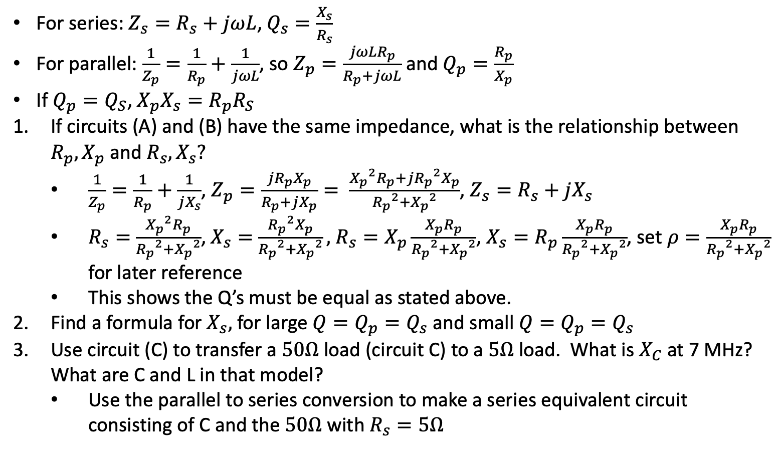
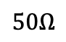
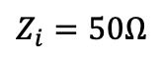
Exercise 7: Parallel to Series conversion
For series: $Z_{s}=R_{s}+jωL$, $Q_{s}=\frac{X_{s}}{R_{s}}$
For parallel: $\frac{1}{Z_{p}}=\frac{1}{R_{p}}+\frac{1}{jωL}$, so $Z_{p}=\frac{jωLR_{p}}{R_{p}+jωL}$ and $Q_{p}=\frac{R_{p}}{X_{p}}$
If $Q_{p}=Q_{S}$, $X_{p}X_{s}=R_{p}R_{S}$
If circuits (A) and (B) have the same impedance, what is the relationship between $R_{p},X_{p}$ and $R_{s},X_{s}?$
$\frac{1}{Z_{p}}=\frac{1}{R_{p}}+\frac{1}{jX_{s}}$, $Z_{p}=\frac{j{R_{p}X}_{p}}{R_{p}+jX_{p}}= \frac{{X_{p}}^{2}R_{p}+j{R_{p}}^{2}X_{p}}{{R_{p}}^{2}+{X_{p}}^{2}}$, $Z_{s}=R_{s}+jX_{s}$
$R_{s}=$ $\frac{{X_{p}}^{2}R_{p}}{{R_{p}}^{2}+{X_{p}}^{2}}$, $X_{s}=$ $\frac{{R_{p}}^{2}X_{p}}{{R_{p}}^{2}+{X_{p}}^{2}},$ $R_{s}=X_{p}\frac{X_{p}R_{p}}{{R_{p}}^{2}+{X_{p}}^{2}}$, $X_{s}=R_{p}\frac{X_{p}R_{p}}{{R_{p}}^{2}+{X_{p}}^{2}}$, set $ρ=\frac{X_{p}R_{p}}{{R_{p}}^{2}+{X_{p}}^{2}}$ for later reference
This shows the Q’s must be equal as stated above.
Find a formula for $X_{s},$ for large $Q=Q_{p}=Q_{s}$ and small $Q=Q_{p}=Q_{s}$
Use circuit (C) to transfer a $50Ω$ load (circuit C) to a $5Ω$ load. What is $X_{C}$ at 7 MHz? What are C and L in that model?
Use the parallel to series conversion to make a series equivalent circuit consisting of C and the $50Ω$ with $R_{s}=5Ω$
A
R_{p}
jX_{p}
B
R_{s}
jX_{s}
L
C
$$Z_{i}=50Ω$$
C
$$50Ω$$

Slide 23
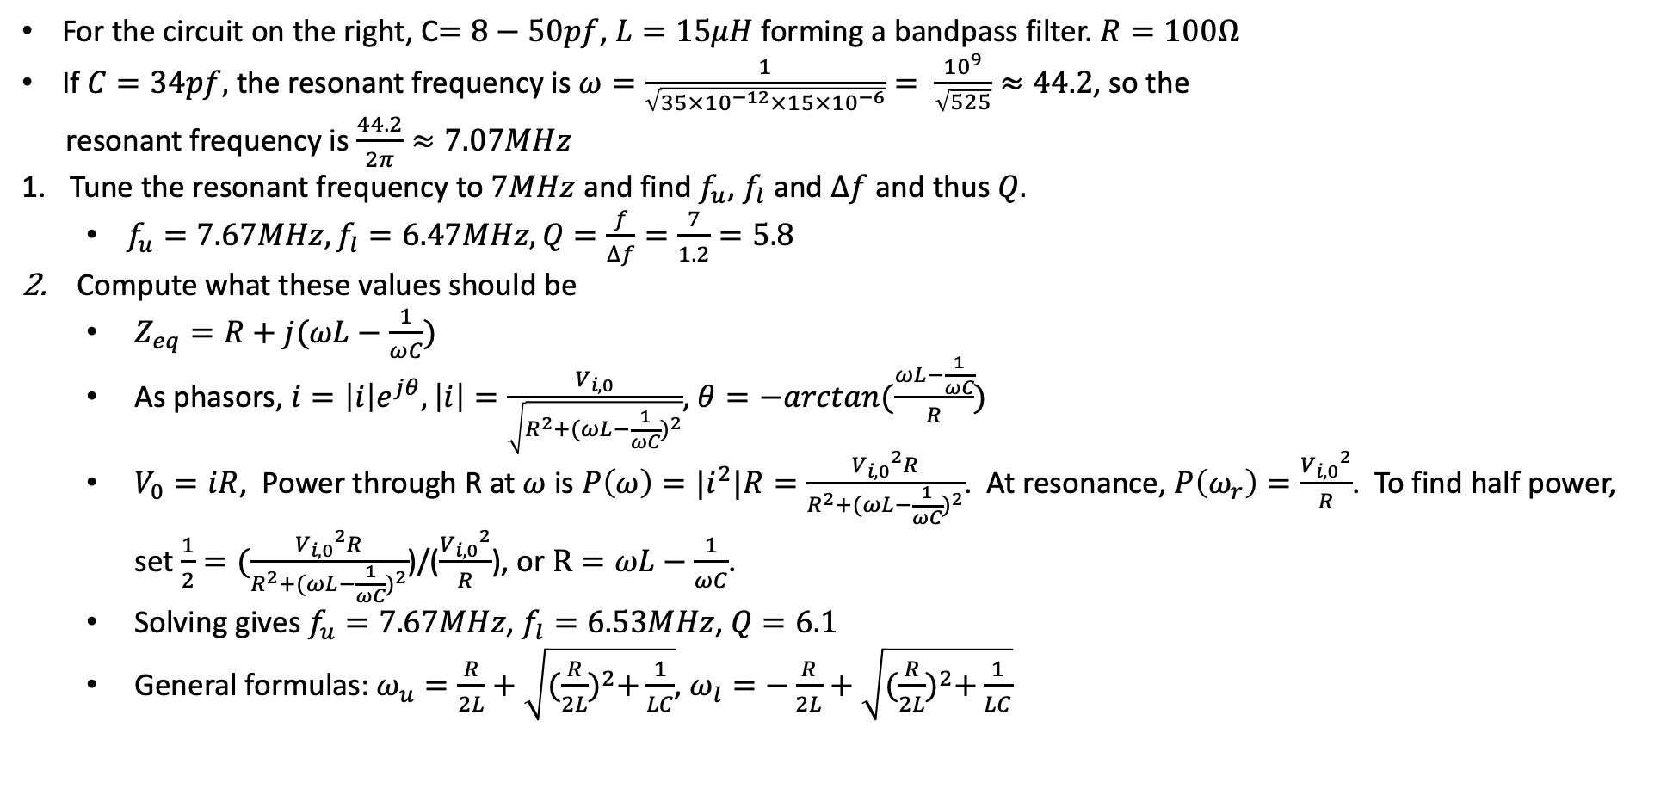
Exercise 8: Series resonance
For the circuit on the right, C$=8−50pf$, $L=15μH$ forming a bandpass filter. $R=100Ω$
If $C=34pf,$ the resonant frequency is $ω=\frac{1}{\sqrt{35×{10}^{−12}×15×{10}^{−6}}}= \frac{{10}^{9}}{\sqrt{525}}≈44.2$, so the
resonant frequency is $\frac{44.2}{2π}≈7.07MHz$
Tune the resonant frequency to $7MHz$ and find $f_{u}$, $f_{l}$ and $∆f$ and thus $Q.$
$f_{u}=7.67MHz, f_{l}=6.47MHz, Q=\frac{f}{∆f}=\frac{7}{1.2}=5.8$
Compute what these values should be
$Z_{eq}=R+j(ωL−\frac{1}{ωC})$
As phasors, $i=\left|i\right|e^{jθ}, \left|i\right|=\frac{V_{i,0}}{\sqrt{R^{2}+{(ωL−\frac{1}{ωC})}^{2}}}$, $θ=−arctan(\frac{ωL−\frac{1}{ωC}}{R})$
$V_{0}=iR$, Power through R at $ω$ is $P\left(ω\right)={|i}^{2}|R=\frac{{V_{i,0}}^{2}R}{R^{2}+{(ωL−\frac{1}{ωC})}^{2}}$. At resonance, $P\left(ω_{r}\right)=\frac{{V_{i,0}}^{2}}{R}$. To find half power, set $\frac{1}{2}=(\frac{{V_{i,0}}^{2}R}{R^{2}+{(ωL−\frac{1}{ωC})}^{2}}$)/($\frac{{V_{i,0}}^{2}}{R}$), or $R=ωL−\frac{1}{ωC}$.
Solving gives $f_{u}=7.67MHz$, $f_{l}=6.53MHz$, $Q=6.1$
General formulas: $ω_{u}=\frac{R}{2L}+\sqrt{{(\frac{R}{2L})}^{2}+\frac{1}{LC}}$, $ω_{l}=−\frac{R}{2L}+\sqrt{{(\frac{R}{2L})}^{2}+\frac{1}{LC}}$
C
L
V_{i}
R
V_{o}

Slide 24
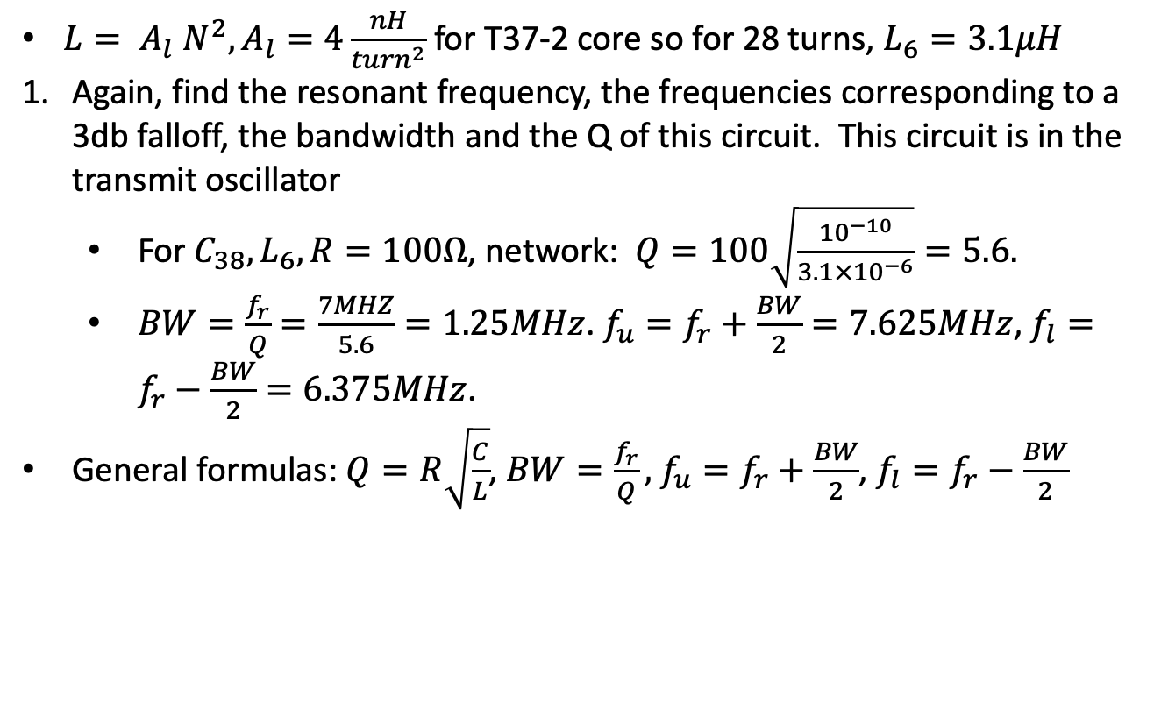
Exercise 9: Parallel resonance
$L= A_{l} N^{2}, A_{l}=4\frac{nH}{{turn}^{2}}$ for T37-2 core so for 28 turns, $L_{6}=3.1μH$
Again, find the resonant frequency, the frequencies corresponding to a 3db falloff, the bandwidth and the Q of this circuit. This circuit is in the transmit oscillator
For $C_{38}, L_{6}, R=100Ω$, network: $Q=100\sqrt{\frac{{10}^{−10}}{3.1×{10}^{−6}}}=5.6.$
$BW=\frac{f_{r}}{Q}=\frac{7MHZ}{5.6}=1.25MHz$. $f_{u}=f_{r}+\frac{BW}{2}=7.625MHz$, $f_{l}=f_{r}−\frac{BW}{2}=6.375MHz$.
General formulas: $Q=R\sqrt{\frac{C}{L}}$, $BW=\frac{f_{r}}{Q},$ $f_{u}=f_{r}+\frac{BW}{2}$, $f_{l}=f_{r}−\frac{BW}{2}$
C₃₇
5pF
V_{i}
V_{o}
L₆
R
C₃₈
100pF

Slide 25
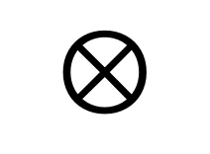
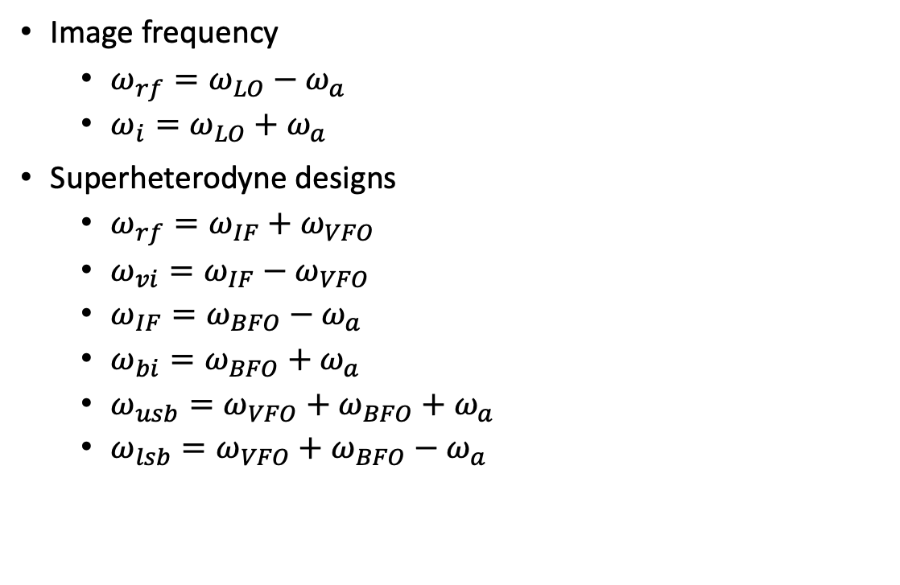
Direct conversion and superhet receivers
Image frequency
$ω_{rf}=ω_{LO}−ω_{a}$
$ω_{i}=ω_{LO}+ω_{a}$
Superheterodyne designs
$ω_{rf}=ω_{IF}+ω_{VFO}$
$ω_{vi}=ω_{IF}−ω_{VFO}$
$ω_{IF}=ω_{BFO}−ω_{a}$
$ω_{bi}=ω_{BFO}+ω_{a}$
$ω_{usb}=ω_{VFO}+ω_{BFO}+$ $ω_{a}$
$ω_{lsb}=ω_{VFO}+ω_{BFO}−$ $ω_{a}$
RF
Filter
$$⊗$$
RF Mixer
LO
Audio
Amp
Direct conversion

Slide 26
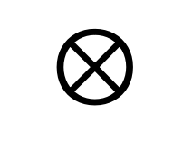
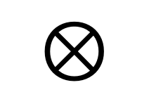
Norcal 40A
7 MHz
2W
<10 MHz
Harmonic
Filter
RF
Filter
Power
Amp
$$⊗$$
RF Mixer
20 mW
4.9 MHz
9.1 MHz
Driver
IF Filter
300 uW
VFO
2.1 MHz
Product
Detector
Buffer
$$⊗$$
BFO
4.9 MHz
10 uW
9.8 MHz
Audio
Transmit
Filter
AGC
7 MHz
2.8 MHz
$$⊗$$
Transmit
Mixer
AGC
Detector
Audio
Amp
Key
Transmit oscillator
4.9 MHz

Slide 27
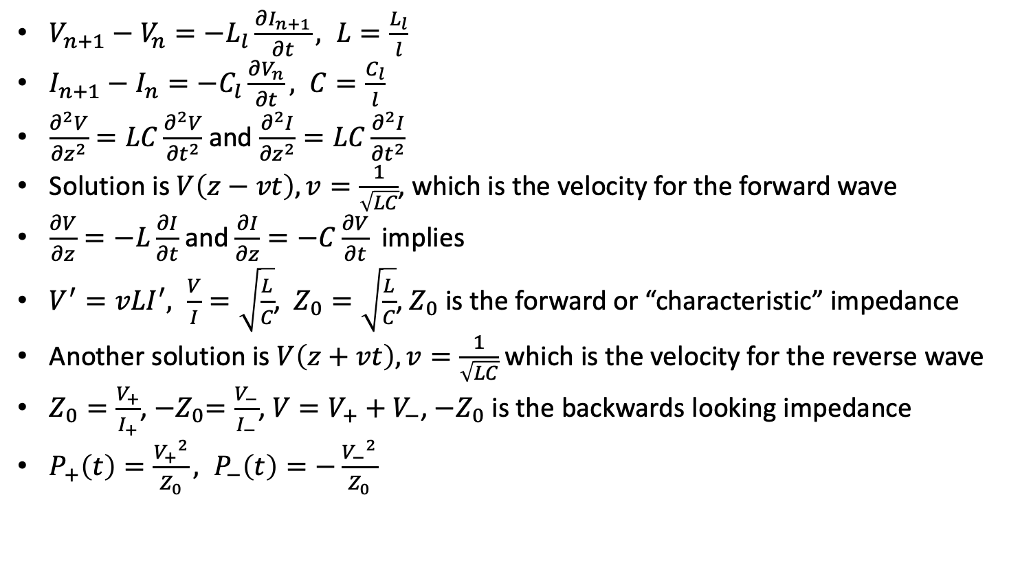
Transmission Lines
I_{n}
V_{n}
$V_{n+1}−V_{n}=−L_{l}\frac{∂I_{n+1}}{∂t}, L=\frac{L_{l}}{l}$
$I_{n+1}−I_{n}=−C_{l}\frac{∂V_{n}}{∂t}, C=\frac{C_{l}}{l}$
$\frac{∂^{2}V}{{∂z}^{2}}=LC\frac{∂^{2}V}{{∂t}^{2}}$ and $\frac{∂^{2}I}{{∂z}^{2}}=LC\frac{∂^{2}I}{{∂t}^{2}}$
Solution is $V\left(z−vt\right), v=\frac{1}{\sqrt{LC}}$, which is the velocity for the forward wave
$\frac{∂V}{∂z}=−L\frac{∂I}{∂t}$ and $\frac{∂I}{∂z}=−C\frac{∂V}{∂t}$ implies
$V^{′}=vLI^{′}, \frac{V}{I}=\sqrt{\frac{L}{C}}$, $Z_{0}=\sqrt{\frac{L}{C}}$, $Z_{0}$ is the forward or “characteristic” impedance
Another solution is $V\left(z+vt\right), v=\frac{1}{\sqrt{LC}}$ which is the velocity for the reverse wave
$Z_{0}=\frac{V_{+}}{I_{+}}$, ${−Z}_{0}=\frac{V_{−}}{I_{−}}$, $V=V_{+}+V_{−}$, ${−Z}_{0}$ is the backwards looking impedance
$P_{+}\left(t\right)=\frac{{V_{+}}^{2}}{Z_{0}}, P_{−}\left(t\right)=−\frac{{V_{−}}^{2}}{Z_{0}}$
L_{l}
…
C_{l}
I₊
V₊
P₊
I₋
P₋
V₋

Slide 28
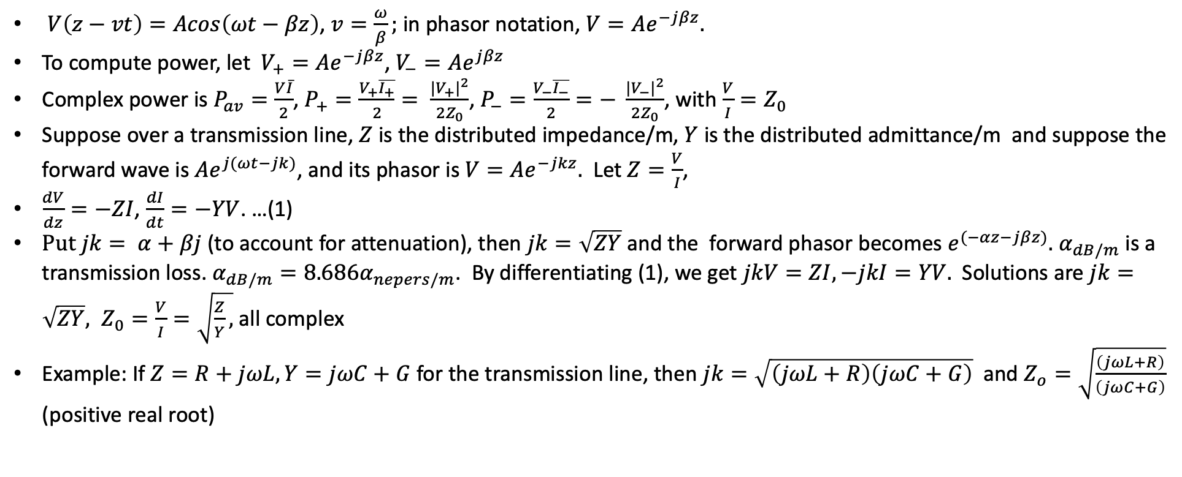
Transmission Lines - continued
$V\left(z−vt\right)=Acos\left(ωt−βz\right)$, $v=\frac{ω}{β};$ in phasor notation, $V=Ae^{−jβz}.$
To compute power, let $V_{+}=Ae^{−jβz}$, $V_{−}=Ae^{jβz}$
Complex power is $P_{av}=\frac{V\overline{I}}{2}$, $P_{+}=\frac{V_{+}\overline{I_{+}}}{2}= \frac{|{V_{+}|}^{2}}{2Z_{0}}$, $P_{−}=\frac{V_{−}\overline{I_{−}}}{2}=− \frac{{{|V}_{−}|}^{2}}{2Z_{0}}$, with $\frac{V}{I}=Z_{0}$
Suppose over a transmission line, $Z$ is the distributed impedance/m, $Y$ is the distributed admittance/m and suppose the forward wave is $Ae^{j(ωt−jk)}$, and its phasor is $V=Ae^{−jkz}.$ Let $Z=\frac{V}{I}$,
$\frac{dV}{dz}=−ZI$, $\frac{dI}{dt}=−YV$. …(1)
$Put jk= α+βj$ (to account for attenuation), then $jk=\sqrt{ZY}$ and the forward phasor becomes $e^{(−αz−jβz)}.$ $α_{dB/m}$ is a transmission loss. $α_{dB/m}=8.686α_{nepers/m}$. By differentiating (1), we get $jkV=ZI, −jkI=YV.$ Solutions are $jk=\sqrt{ZY}, Z_{0}=\frac{V}{I}=\sqrt{\frac{Z}{Y},}$ all complex
Example: If $Z=R+jωL, Y=jωC+G$ for the transmission line, then $jk=\sqrt{\left(jωL+R\right)\left(jωC+G\right)}$ and $Z_{o}=\sqrt{\frac{\left(jωL+R\right)}{\left(jωC+G\right)}}$ (positive real root)

Slide 29
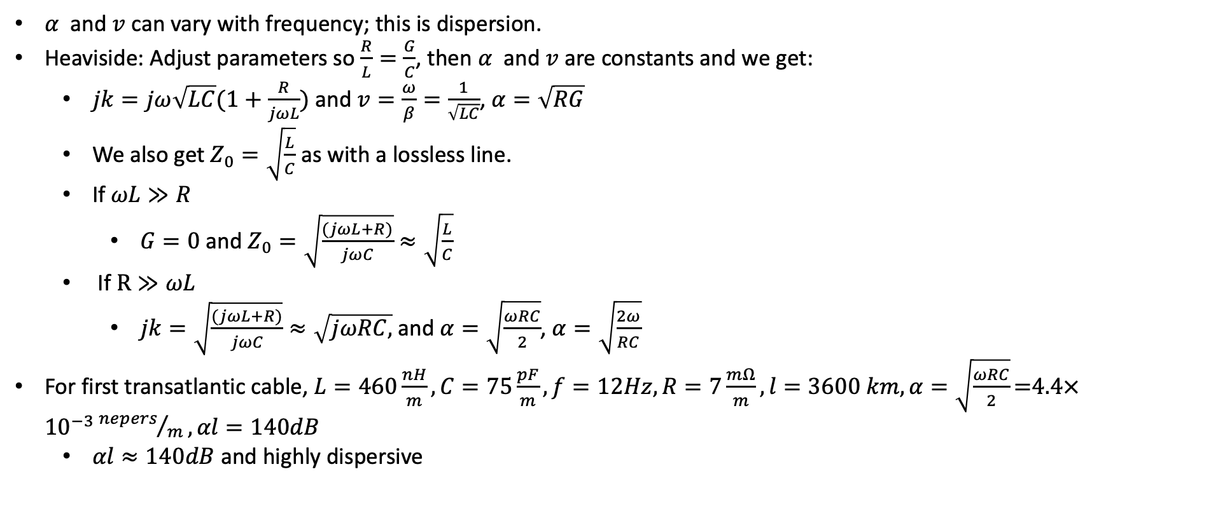
Transmission Lines - dispersion
$α$ and $v$ can vary with frequency; this is dispersion.
Heaviside: Adjust parameters so $\frac{R}{L}=\frac{G}{C}$, then $α$ and $v$ are constants and we get:
$jk=jω\sqrt{LC}(1+\frac{R}{jωL})$ and $v=\frac{ω}{β}=\frac{1}{\sqrt{LC}}$, $α=\sqrt{RG}$
We also get $Z_{0}=\sqrt{\frac{L}{C}}$ as with a lossless line.
If $ωL≫R$
$G=0$ and $Z_{0}=\sqrt{\frac{(jωL+R)}{jωC}}≈\sqrt{\frac{L}{C}}$
If $R≫ωL$
$jk=\sqrt{\frac{(jωL+R)}{jωC}}≈\sqrt{jωRC,}$ and $α=\sqrt{\frac{ωRC}{2}}$, $α=\sqrt{\frac{2ω}{RC}}$
For first transatlantic cable, $L=460\frac{nH}{m}, C=75\frac{pF}{m}, f=12Hz, R=7\frac{mΩ}{m}, l=3600 km, α=\sqrt{\frac{ωRC}{2}}\text{=4.4}×{10}^{−3}{nepers}/m, αl=140dB$
$αl≈140dB$ and highly dispersive

Slide 30
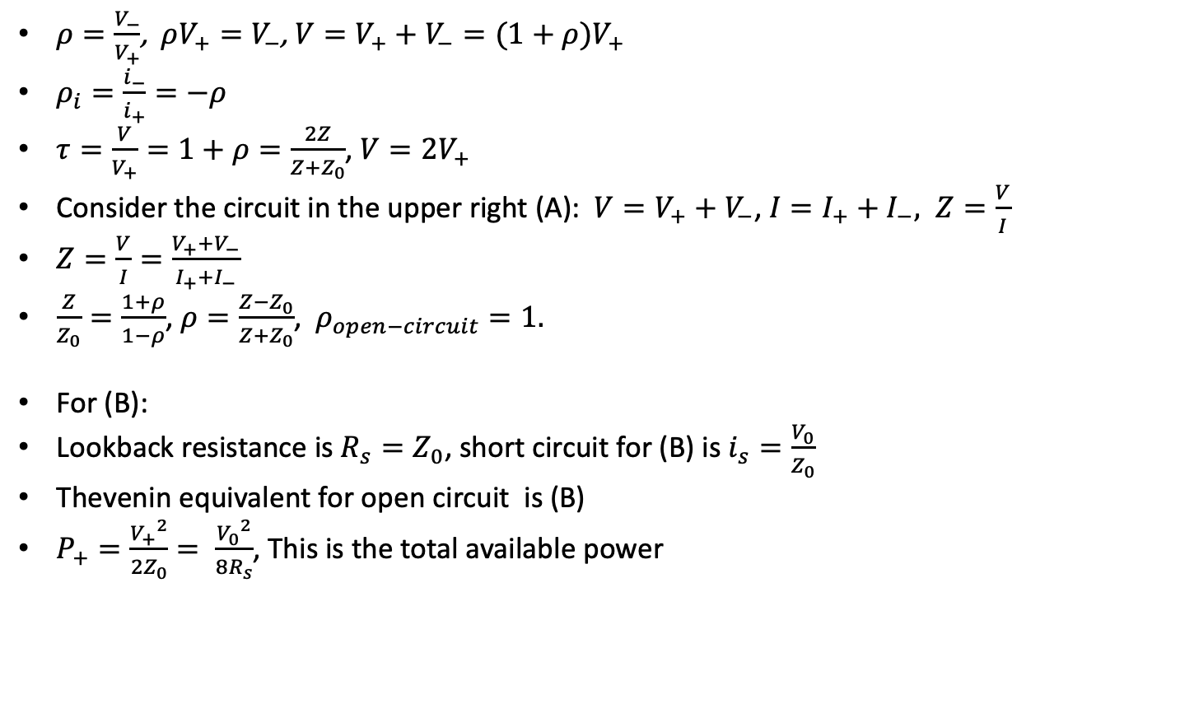
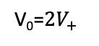
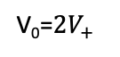
Transmission Lines-reflections
V₊
I
$ρ=\frac{V_{−}}{V_{+}}$, $ρV_{+}=V_{−}$, $V=V_{+}+V_{−}=(1+ρ)V_{+}$
$ρ_{i}=\frac{i_{−}}{i_{+}}=−ρ$
$τ=\frac{V}{V_{+}}=1+ρ=\frac{2Z}{Z+Z_{0}}$, $V=2V_{+}$
Consider the circuit in the upper right (A): $V=V_{+}+V_{−}$, $I=I_{+}+I_{−}, Z=\frac{V}{I}$
$Z=\frac{V}{I}=\frac{V_{+}+V_{−}}{I_{+}+I_{−}}$
$\frac{Z}{Z_{0}}=\frac{1+ρ}{1−ρ}$, $ρ=\frac{Z−Z_{0}}{Z+Z_{0}}$, $ρ_{open−circuit}=1.$
For (B):
Lookback resistance is $R_{s}=Z_{0}$, short circuit for (B) is $i_{s}=\frac{V_{0}}{Z_{0}}$
Thevenin equivalent for open circuit is (B)
$P_{+}=\frac{{V_{+}}^{2}}{2Z_{0}}= \frac{{V_{0}}^{2}}{8R_{s}}$, This is the total available power
Z₀
V
Z
(A)
V₋
V₊
Z₀
V₀=${2V}_{+}$
Z₀
V₀=${2V}_{+}$
(B)

Slide 31
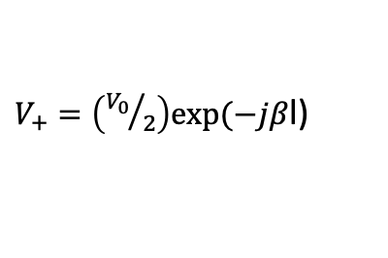
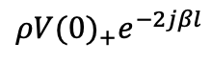
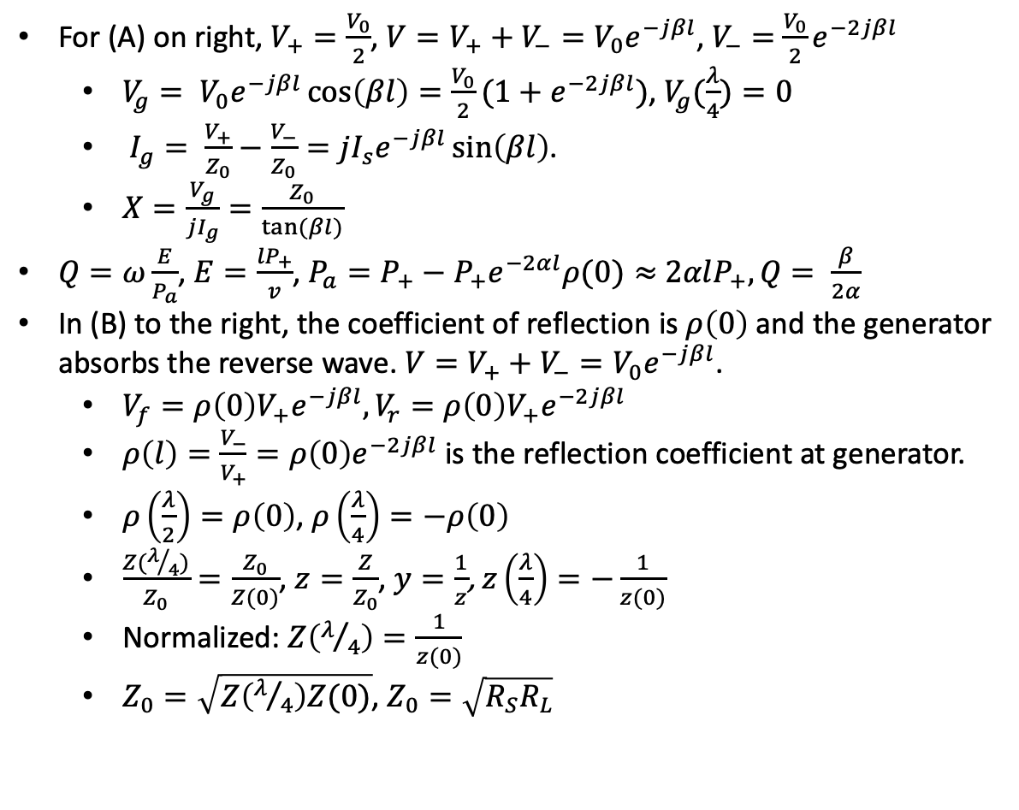

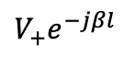
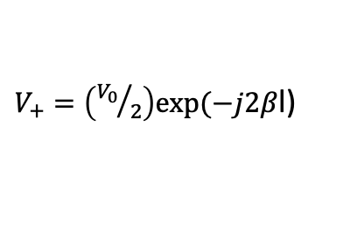
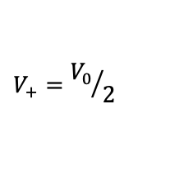
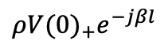


Transmission Lines – resonance and Q
For (A) on right, $V_{+}=\frac{V_{0}}{2}$, $V=V_{+}+V_{−}=V_{0}e^{−jβl}$, $V_{−}=$ $\frac{V_{0}}{2}e^{−2jβl}$
$V_{g}= V_{0}e^{−jβl}\cos\left(βl\right)=\frac{V_{0}}{2}(1+e^{−2jβl})$, $V_{g}(\frac{λ}{4})=0$
$I_{g}= \frac{V_{+}}{Z_{0}}−\frac{V_{−}}{Z_{0}}=jI_{s}e^{−jβl}\sin\left(βl\right)$.
$X=\frac{V_{g}}{jI_{g}}=\frac{Z_{0}}{tan⁡(βl)}$
$Q=ω\frac{E}{P_{a}}$, $E=\frac{{lP}_{+}}{v}$, $P_{a}=P_{+}−P_{+}e^{−2αl}ρ(0)≈$ $2αlP_{+}, Q= \frac{β}{2α}$
In (B) to the right, the coefficient of reflection is $ρ\left(0\right)$ and the generator absorbs the reverse wave. $V=V_{+}+V_{−}=V_{0}e^{−jβl}$.
$V_{f}={ρ\left(0\right)V}_{+}e^{−jβl}, V_{r}={ρ\left(0\right)V}_{+}e^{−2jβl}$
$ρ\left(l\right)=\frac{V_{−}}{V_{+}}={ρ\left(0\right)e}^{−2jβl}$ is the reflection coefficient at generator.
$ρ\left(\frac{λ}{2}\right)=ρ\left(0\right)$, $ρ\left(\frac{λ}{4}\right)=−ρ\left(0\right)$
$\frac{Z(λ/4)}{Z_{0}}=\frac{Z_{0}}{Z(0)}$, $z=\frac{Z}{Z_{0}}$, $y=\frac{1}{z}$, $z\left(\frac{λ}{4}\right)=−\frac{1}{z(0)}$
Normalized: $Z\left(λ/4\right)=\frac{1}{z(0)}$
$Z_{0}=\sqrt{Z\left(λ/4\right)Z(0)}$, $Z_{0}=\sqrt{R_{S}R_{L}}$
$V_{+}=\left({V_{0}}/2\right)exp⁡(−jβ$l)
$$V_{+}={V_{0}}/2$$
Z₀
Z₀
$$l$$
V
V_{g}
$V_{−}=\left({V_{0}}/2\right)exp⁡(−jβ$l)
V₀
A
$V_{+}=\left({V_{0}}/2\right)exp⁡(−j2β$l)
$$V_{+}e^{−jβl}$$
(B)
Z₀, l
$$ρ(0)$$
$${ρV(0)}_{+}e^{−jβl}$$
$${ρV(0)}_{+}e^{−2jβl}$$

Slide 32











Exercise 10: Coax
$$Generator and scope 1$$
10m
$$scope 2$$
We’ll measure the velocity of waves in RG58U by connecting one channel of the scope to the input and one to the output.
Measure the velocity, v, in 10m coax at 7MHz. Try different frequencies. Use $50ns$, $5V_{pp}$using square waves at 20kHz.
Do the same with an antenna
Calculate $Z_{0}$ with $50Ω$ termination for the circuit on the right.
Remove the $50Ω$ and measure the V and use it and $Z_{0}$ to calculate L, and C for the coax
Measured speed is $v=2×{10}^{8} m/s$. $Z_{0}=50Ω$ . For high impedance, $Z_{0}=\sqrt{\frac{L}{C}}$ and $v= \frac{1}{\sqrt{LC}}$. So, ${Z_{0}}^{2}C=L$ and $v^{2}=\frac{1}{LC}$, so ${Z_{0}}^{2}C^{2}v^{2}$=1. $C=\frac{1}{Z_{0}v}={10}^{−10}F$. ${2500×10}^{−10}F=L=250nH,$ which is what we use in the next problem.
Z₀, l
$$V$$
$$V_{i}$$
50$Ω$
50$Ω$
Function generator
1:1
50$Ω$
scope channel 2 (I)
$$Z_{0}$$
1$Ω$
10m cable
50$Ω$
scope channel 1 (V)

Slide 33







Exercise 11: Waves
Suppose we want to send voice over 100km of coax, $Z_{L}=50Ω, l=100km.$
Measure the SWR which is the ratio of the maximum to minimum output
$V=V_{+}+V_{−}$, $ρ=\frac{Z−Z_{0}}{Z+Z_{0}}$, $Z=50Ω$, we get $Z_{0}$ from the previous exercise.
$\left|V_{max}\right|=\left|V_{f}\right|+\left|V_{r}\right|=(1+ρ)\left|V_{f}\right|,\left|V_{min}\right|=\left(1−ρ\right)\left|V_{f}\right|=\left|V_{f}\right|$. $SWR=\frac{V_{max}}{V_{min}}=\frac{1+ρ}{1−ρ},$
If $L=250\frac{nH}{m}, C=100pf/m$ and the distributed resistance at voice is $50 mΩ/m$, calculate total dB loss at 500, 1000 and 2000Hz using the high frequency approximation.
$Z\left(f\right)=jωL+R=50×{10}^{−3}+j∙2πf∙250×{10}^{−9}$
$Y(f)=jωC+\frac{1}{R}= \frac{1}{50×{10}^{−3}}+j$ $2πf∙{10}^{−10}$
$Z_{0}\left(f\right)= \sqrt{\frac{Z\left(f\right)}{Y\left(f\right)}}$
$Z_{0}(500)=400Ω$, $Z_{0}(1000)=282Ω$, $Z_{0}(500)=200Ω$,
High resistance approximation: $α(f)=\sqrt{\frac{ωRC}{2}}$,
$α\left(500\right)=8.8×{10}^{−5},α\left(1000\right)=12.6×{10}^{−5}$
$α\left(2000\right)=17.6×{10}^{−5}×{10}^{5}$
For $100km,$ loss is $α×{10}^{5}$
$$Generator and scope 1$$
$$scope 2$$
Z₀, l
$$V$$
$$V_{i}$$
50$Ω$
50$Ω$

Slide 34

Exercise 11: Waves
Add a 100mH inductor every 1km. Now what’s the loss?
$Z\left(f\right)=jωL+R=50×{10}^{−3}+j∙2πf∙{10}^{−4}, { Z}_{0}\left(f\right)= \sqrt{\frac{Z\left(f\right)}{Y\left(f\right)}}$
$Z_{0}\left(f\right)= \sqrt{\frac{Z\left(f\right)}{Y\left(f\right)}}$
$Z_{0}(500)=318Ω$, $Z_{0}(1000)=317Ω$, $Z_{0}(2000)=316Ω$
High reactance approximation: $α(f)=\frac{R}{2Z_{0}}$ , $Z_{0}=\sqrt{\frac{L}{C}}=1000Ω$
$α(f)=\frac{R}{2Z_{0}(f)}$, $α\left(500\right)=α\left(1000\right)=α\left(2000\right)=\frac{5×{10}^{−2}}{2000}=5.5×{10}^{−5} nepers/m$
For $100km,$ loss is $α×{10}^{5}$=5.5 or $5.5 ×8.868≈49dB$

Slide 35




Exercise 12: Resonance
$RG58U$ has a capacitance of about $100\frac{pF}{m}.$Let $α$ be the attenuation constant and $β$ be the phase
Derive an expression for $|\frac{V_{g}}{V}|$ and assuming $α$ is small by finding the first resonance where $V_{g}$ is minimum.
$V_{g}=V_{0}e^{−jβl}cos⁡(βl)$, $V=V_{0}\exp\left(−jβl\right)$. $\left|\frac{V_{g}}{V}\right|=cos⁡(βl)\text{.}$ So, at $l=\frac{λ}{2}$, $\left|V_{g}\right|=|V|$
Find $α$and the wave velocity by finding the resonant frequency (without the load, ${1V}_{pp}$) and noting the time delay with a scope on the input and output. Use $|\frac{V_{g}}{V}|$ to calculate $α$.
$|V|$ will be maximum at resonant frequency with unterminated line.
$|V_{g}(l)|$ is minimum when $l=\frac{λ_{r}}{4}$ and $βl=\frac{π}{4}$. This gives $β$.
At $l=\frac{λ}{2}$, $\left|\frac{V_{g}}{V}\right|=e^{−α(λ/2)}$
Use this to calculate the velocity, $v$. How large is the frequency shift caused?
$v=\frac{ω_{r}}{β}$. [$v$ should be about $2×{10}^{8} m/s$]
Find, as usual, $f_{u}$, $f_{l}$, and $Q.$
$Q=\frac{β}{2α}$
$Q= \frac{f_{r}}{BW}$, so $BW= \frac{f_{r}}{Q}$. $f_{u}=f_{r}+ \frac{BW}{2}$, and $f_{l}=f_{r}− \frac{BW}{.2}$
10m
Z₀
$$V$$
$$V_{g}$$
$$Z_{0}, l$$
V₀
Scope channel 2, no load
Scope channel 1 and function generator

Slide 36



Filters
L₂
L₄
Circuits on the left are called ladder filters.
Low pass (Butterworth equivalent): Tabled values for inductors and capacitors based on frequency and dB drop-off.
Can convert low pass into bandpass.
For low pass to high pass
Butterworth: $L=\frac{P_{i}}{P}=1+{(\frac{f}{f_{c}})}^{2n}$, $f_{c}$ is 3dB cutoff
Chebyshev: $L=1+{α{C_{n}}^{2}(\frac{f}{f_{c}})}^{2n}$, $f_{c}$ is 3dB cutoff
Normalized reactance's: $a_{i}=sin⁡(\frac{(2i−1)π}{2n})$
Ripple loss: $1+α={10}^{{L_{r}}/{10}}$
$β=sinh⁡(\frac{\tanh^{−1}(1/{\sqrt{1+α}})}{n})$, $c_{i}=\frac{a_{i}a_{i−1}}{c_{i−1}(β^{2}+\sin^{2}({(i−1)π}/n))}$
Example: cutoff at 10MHz, 4th order, 50ohm output, 3dB cutoff, $L\left(20MHz\right)=6n=24dB$, $a_{1}=0.765, X_{1}=x_{1}Z_{0}=38Ω$, $L_{1}=\frac{X_{1}}{ω_{c}}=610nH, b_{2}=a_{2}=1.848, B_{2}={b_{2}}/{Z_{0}}$, $C_{2}={B_{2}}/{ω_{c}}$
Yuck!
C₁
C₂
C₃
R_{L}
Low pass
C₁
C₂
C₃
Bandpass - WIkipedia
L₂
L₄
High pass
C₁ (34.5 pF)
L₂ (15 uH)
C₂ (6nF)
R_{L}
L₄ (8nH)
7 MHz bandpass
Lowpass - WIkipedia

Slide 37

Norcal transmit bandpass filter
$C_{39}=50pF$,
$L_{6}$ is 36 turns #28 on T37-2 which has $A_{l}=4\frac{nH}{{turn}^{2}}, L_{6}= A_{l} ∙{36}^{2}=3.1μH$
$Z_{2}=−\frac{j}{\left(C_{38}+C_{39}\right)ω_{o} }, Z_{3}=jL_{6}ω_{o}$, $Z_{1}= \frac{j}{C_{37}ω_{o}}$
$Z_{2,3−eq}= \frac{jL_{6}ω_{0}}{L_{6}\left(C_{38}+C_{39}\right){ω_{0}}^{2}−1}$
Resonance is when $Z_{2,3−eq}→∞, {ω_{o}}^{2}=\frac{1}{(C_{38}+C_{30})L_{6}} ≈ \frac{{10}^{18}}{465}$, when almost all the voltage drop is across $Z_{2,3−eq}$ $ω_{o}=\frac{{10}^{9}}{\sqrt{465}}≈50.8×{10}^{6}, f_{0}=\frac{ω_{o}}{2π}≈7.1 MHz$
Q of filter is: $Q_{s}=\frac{X_{s}}{R_{s}}$. $R_{s}$ comes from the other components and must be measured
Note that $Z_{2,3−eq}$ is small for the other modulation product
C37 (5pF)
C₃₉
C₃₈ (100pF)
L₆

Slide 38

Exercise 13: Norcal Harmonic Filter
L₇
L₈
L₇, L₈ use T37-2 core, 18 turns, 1.3uH. Use $50Ω$ termination and set function generator at 10V_{pp}.
Compute and compare loss at 7MHz and 14MHz.
From $A_{l}=5nH/{turn}^{2}$, calculate $L_{7}$ and $L_{8}.$
What is the spur strength at 7, 14 and 28MHz? Measure and calculate.
Need Puff (a simulator) to get losses. However, there is a 6dB drop-off at every frequency doubling
C₄₅
330pF
Antenna
Jack out
C₄₆
820pF
C₄₇
330pF

Slide 39

Exercise 14: Norcal IF Cohn Filter
C₉
X₁
X₂
X₃
X₄
C₁₃
X₁ through X₄ are 4.91 MHz
C₁₀, C₁₁, C₁₂ are 270 pF
Set function generator to 50mV_{pp} from function generator
Calculate R and X for filter
Measure the resonant frequency of one of the crystals
Duh
Calculate the parameters of the crystal. Omitting $C_{s}$
$f_{r}=\frac{1}{2π\sqrt{LC}}$ and $Q=\frac{1}{R}\sqrt{\frac{L}{C}}$. We can measure $f_{r}$ and find Q using the 3dB bandwidth. $R$ is the resistance at resonance.
$Q≈80$
$25Ω<R<100Ω$
If $R=50$, $C=8.1pF$, $L=130μH$
C₁₀
C₁₁
C₁₂
L₉ (18 uH)
C₁₄
47pF
SA602 wants 1.5K
Matching network
C_{s}
L
C
R
Equivalent circuit for crystal

Slide 40

Transformers
For solenoid, $\oint{B∙}ds= μ_{0}nI$ inside
$LI=Φ_{B}$. Since there are n turns in the solenoid, over the solenoid, $LI=$ $μ_{0}n^{2}I$, so $L=μ_{0}n^{2}$.
This is the source of $L=A_{l}n^{2}$
$V_{s}=\frac{N_{s}}{N_{p}}V_{p}$
$Z_{p}={(\frac{N_{p}}{N_{s}})}^{2}Z_{s}$

Slide 41






Exercise 15: Norcal Driver Transformers
$\text{T}\text{1} \text{uses} \text{FT}\text{ 37−43.}$ $L\left(μH\right)=\frac{A_{L}t^{2}}{1000}$, $A_{L}=350. f_{r}=7×{10}^{6}MHz$, $n_{p}=14, n_{s}=4$, $ω_{r}=2π×7×{10}^{6}MHz=4.4×{10}^{7}$
$\text{Measure} \text{the}$ output $V_{out}$.
Calculate $V_{out}$
$L_{p}=68.6μH$, $L_{s}=5.6μH$
$Z_{eq,in}(ω)=1250+j\left(ωL_{p}\right),{ Z}_{eq,in}(ω_{r})=1250+3016j$, $\left|Z_{eq,in}(ω_{r})\right|=3264$
$Z_{eq,out}\left(ω\right)=33+jωL_{s}, Z_{eq,out}(ω_{r})=33+j246,$ $\left|Z_{eq,out}(ω_{r})\right|=248$
$V_{t,in}=\frac{3016}{3264}V_{in}$
${V_{out}=V}_{t,out}= \frac{n_{s}}{n_{p}}V_{t,in}=.29V_{t,in}=.29×\frac{3016}{3264}×5=1.3V$
$i_{p}\left(ω\right)=\frac{V_{in}}{|Z_{eq,in}|}e^{jθ_{p}(ω)}$, $θ_{p}\left(ω\right)=\arctan\left(\frac{ωL_{p}}{1250}\right); i_{s}\left(ω\right)=\frac{V_{out}}{|Z_{eq,out}|}e^{jθ_{s}(ω)}$,$θ_{s}\left(ω\right)=\arctan\left(\frac{ωL_{s}}{33}\right)$.
$P_{in,a}=Re\left(\frac{V_{in}\overline{I_{in}}}{2}\right)=Re(\frac{{V_{in}}^{2}}{2\left|Z_{eq,in}\left(ω\right)\right|}e^{jθ_{p}\left(ω\right)})$
$P_{out,a}=Re\left(\frac{V_{out}\overline{I_{out}}}{2}\right)=Re(\frac{{V_{out}}^{2}}{2\left|Z_{eq,out}\left(ω\right)\right|}e^{jθ_{s}\left(ω\right)})$
T₁, 14:4
10V_{pp}
50$Ω$
200$Ω$
100$Ω$
50$Ω$
1K$Ω$

Slide 42

Exercise 15: Norcal Driver Transformers
$\cos\left(θ_{s}\left(ω_{r}\right)\right)=.13,\cos\left(θ_{p}\left(ω_{r}\right)\right)=.38,$
$\frac{P_{out,a}(ω_{r})}{P_{in,a}(ω_{r})}={(\frac{V_{out}}{V_{in}})}^{2}\frac{\left|Z_{eq,in}\left(ω_{r}\right)\right|}{\left|Z_{eq,out}\left(ω_{r}\right)\right|}\frac{cos⁡(θ_{s}(ω_{r}))}{cos⁡(θ_{p}\left(ω_{r}\right))}={(\frac{1.3}{5})}^{2}×\frac{3264}{248}×\frac{.13}{.38}=.3$
Measure the 3dB cutoff, f_{c}.
$\frac{P_{out,a}(ω)}{P_{in,a}(ω)}={(\frac{V_{out}}{V_{in}})}^{2}\frac{\left|Z_{eq,in}\left(ω\right)\right|}{\left|Z_{eq,out}\left(ω\right)\right|}\frac{cos⁡(θ_{s}(ω))}{cos⁡(θ_{p}\left(ω\right))}= .15$

Slide 43





Exercise 16: Norcal Tuned Transformers
T₂, 1:20
C₄
5pF
$\text{T}\text{2}\text{, }\text{T}\text{3} \text{are} \text{I}\text{F} \text{matchers} \text{using} \text{FT}\text{ 37−61}$. $A_{L}=55 nH/{turn}^{2}$.
Measure 3dB bandwidth
Find P/P₊
T₂
$P_{a}=Re\left(\frac{V\overline{I}}{2}\right), V= V_{+}+V_{−}$, $ρ=\frac{V_{+}}{V_{−}}= \frac{Z−Z_{0}}{Z+Z_{0}},$ $Z$ is look forward, $Z_{0}$ is look back resistance. $P_{+}=\frac{{V_{+}}^{2}}{2Z_{0}}.$ $L_{in}=55nH, L_{out}=22μH$, $ω=4.4×{10}^{7}$
$Z=50+2.4j$, $Z_{0}=203−4030j$, $ρ=1$, so $V_{+}=V_{−}$, $V=2V_{+}$
$\frac{P}{P_{+}}=\frac{1}{4}$
Similar calculation for T₃.
50$Ω$
1V_{pp}
C₂
50pF
1.5K$Ω$
T₃, 23:6
L₄, 18uH
10V_{pp}
750$Ω$
C₁₄
47pF
C₆
47pF
1.5K$Ω$

Slide 44

Acoustics
$P=P_{0}+P_{e}$,$ρ=ρ_{0}+ρ_{e}$
Gas moves and changes density: Displacement of undisturbed air is $x$. At time $t,$ it’s at $x+χ(x,t)$, so $ρ_{0}∆x= ρ(x+∆x+χ\left(x+∆x,t\right)−x−χ(x,t))$, or $ρ_{0}∆x=$ $ρ(\frac{∂χ(x,t)}{∂x}∆x$ + $∆x)$. So, $ρ_{e}=−ρ_{0}\frac{∂χ}{∂x}$
Change in density causes change in pressure: $P=f(ρ$), $P_{0}+P_{e}=f\left(ρ_{0}+ρ_{e}\right)=f\left(ρ_{0}\right)+ρ_{e}f′(ρ_{0}$), $f^{′}\left(ρ_{0}\right)=κ={(\frac{dP}{dρ})}_{0}$, or $P_{e}=κρ_{e}$
Pressure differences cause motion: $P\left(x,t\right)−P\left(x+∆x,t\right)=−\frac{∂P_{e}}{∂x}∆x$, Newton’s law gives $ρ_{0}\frac{∂^{2}χ}{{∂t}^{2}}=−\frac{∂P_{e}}{∂x}=−κ\frac{∂ρ_{e}}{∂x}$
Substituting (1) into (3) gives $\frac{∂^{2}χ}{{∂t}^{2}}=κ\frac{∂^{2}χ}{{∂x}^{2}}$, put $κ=\frac{1}{{c_{s}}^{2}}$
Solution is $χ\left(x,t\right)=f(x−vt)$ [Different $f$ than above].
To find, $κ={(\frac{dP}{dρ})}_{0}$, note that the flow is adiabatic so $PV^{γ}=C′$ and $ρ$ varies inversely as $V$, so $P=ρ^{γ}C$ , and finally, using $PV=Nkt,$ $κ={(\frac{dP}{dρ})}_{0}=\frac{γkT}{n}$
$L_{p}=20 log⁡(\frac{P}{P_{0}})$, $P_{0}=20 μPa$
Sound | L_{p} | Power density
rustling leaves | 10dB | 1pW/m²
broadcast studio | 20dB | 1pW/m²
classroom | 50dB | 10nW/m²
heavy truck | 90dB | 1nW/m²
Shout at 1m | 100dB | 10mW/m²
jackhammer | 110db | 100mW/m²
jet takeoff at 50m | 120dB | 1W/m²

Slide 45







Bipolar Transistors - I
v_{s}
R_{S}
NPN Model
$V_{f}≈.7V, V_{s}≈.2V$
Conducts when $V_{be}>V_{f}$
$i_{c}=βi_{b}$
$i_{c}=αi_{e}$
$β= \frac{α}{1−α}$ [${=h}_{fe}$, small signal]
$β≈100, β_{r}≈10$
${r_{e}i}_{e}=25mV$, $r_{b}=(1+β)r_{e}$, $r_{e}≈33Ω$
$i_{b}=\frac{v_{be}}{(1+β)r_{e}}$
$g_{m}v_{be}=g_{m}r_{b}i_{b}$
Switch
$G_{s}=\frac{i_{b}}{15mV}$
$R_{S}=2Ω$
Bipolar source model
b
c
$$r_{b}=(1+β)r_{e}$$
$$r_{o}$$
$$βi_{b}$$
e
Bipolar equivalent circuit
 | V_{be} | V_{bc} | V_{ce} | i_{c}
active | $$V_{f}$$ | $${<V}_{f}$$ | >$V_{s}$ | $$βi_{b}$$
rev saturated | <$V_{f}$ | $$V_{f}$$ | <-$V_{s}$ | $$−(β_{r}+1)i_{b}$$
saturated | $$V_{f}$$ | $$V_{f}$$ | $$V_{s}>V_{ce}≻−V_{s}$$ | >$−(β_{r}+1)i_{b}$ $$<βi_{b}$$
cutoff | $${<V}_{f}$$ | $${<V}_{f}$$ | * | 0
c
b
$${βi}_{f}−βi_{r}$$
e
Bipolar model

Slide 46

Bipolar Transistors - II
V_{cc}
c
<V_{f}
NPN Mode
$V_{f}=.7V$
$β=g_{m}r_{π}$
$g_{b}=\frac{i_{b}}{V_{t}}$, $V_{t}≈25mV$, $g_{m}=\frac{i_{c}}{V_{t}}$
DC
$\frac{V_{cc}−2V_{f}}{R_{C}}<i_{c}, βi_{b}=i_{c}$
$V_{c}=V_{cc}−i_{c}R_{C}$
$\frac{V_{cc}−V_{b}}{R_{B}}=i_{b}$
Small signal
Convert to AC only and simplify
Thevienize
Replace transistor with model
r_{C}
r₁
C
b
V_{c}
C
V_{b}
r_{L}
V_{f}
V_{s}
r_{S}
r₂
V_{e}
e
Active
Small signal - original
c
Step 1
V_{f}
V_{c}
r_{S}
b
V_{b}
r_{c}||r_{L}
V_{s}
r₁||r₂
V_{e}
V_{f}
e
Saturated
Small signal

Slide 47


Bipolar Transistors - III
V_{c}
r_{S}
V_{b}
r_{c}||r_{L}
V_{s}
V_{e}
Small signal
Convert to AC only and simplify
Thevienize
$V_{th,in}=V_{s}\frac{r_{1}||r_{2}}{r_{1}||r_{2}+r_{s}}$
$r_{th,in}=r_{s}|\left|r_{1}\right||r_{2}$
$r_{th,out}=r_{C}||r_{L}$
Replace transistor with model
$\frac{V_{be}}{V_{Th,in}}=\frac{r_{π}}{r_{π}+r_{Th,in}}$
$\frac{V_{out}}{V_{be}}=−g_{m} r_{0}|\left|r_{c}\right||r_{L}$
$r_{0}$ is the transistor model resistance between b and c
$A_{gail}=\frac{V_{out}}{V_{s}}$
r₁||r₂
r_{Th,out}
r_{Th,in}
Small signal
Step 2
V_{th,in}
Step 3
Small signal
r_{Th,in}
$$r_{π}$$
r_{Th,out}
V_{th,in}
V_{be}
g_{m}V_{be}
Small signal

Slide 48

Transistor experiment
Experiment A
$V_{cc}=9V$, $R_{1}=22.8kΩ$, $R_{2}=7.2kΩ$, $R_{c}=1kΩ$, $R_{E}=220kΩ.$ 2n3904 transistor, $β=150.$
With no transistor, $R_{2}$ adjusted so $V_{b}=2.36V$. $V_{b}=2.24V,$ $V_{e}=1.54V,$ $V_{c}=1.89V.$ $i_{c}=7mA,$ $i_{b}=46μ$A.
Experiment B
Again, $V_{cc}=9V$, $R_{1}=20kΩ$, $R_{2}=10kΩ$, $R_{c}=1kΩ$, $R_{E}=220kΩ.$ 2n3904 transistor, $β=150.$ With no transistor, $R_{2}$ adjusted so $V_{b}=5.8V$. Put transistor in and $V_{b}=2.4V$.
With transistor, $V_{b}=2.4V,$ $V_{e}=1.7V,$ $V_{c}=1.74V.$ $i_{c}=7mA,$ $i_{b}=46μ$A.
Analyze these with our transistor model.
Now use the Thevenin equivalents to analyze them.
V_{CC}
R₁
R_{C}
V_{b}
V_{c}
V_{e}
R₂
R_{E}

Slide 49

Turn the transistor experiment into a CE amplifier
Add C_{i} and C_{o}. Component values are:
$C_{i}=C_{o}=1μF$
$R_{1}=20kΩ$, $R_{2}=10kΩ$
$R_{C}=1kΩ$, $R_{E}=220Ω$
$V_{cc}=9V$
Use a function generator to generate a $V_{pp}=800mV$, 10kHz.
The input impedance is $Z_{in}=R_{1}|\left|R_{2}\right||(β+1)R_{E}$, and the output impedance is $Z_{out}=R_{C}$. Add a load $R_{L}$ whose value is $Z_{out}$.
Now connect a scope to the output and measure the gain. Calculate what it should be an compare them. How do the input and output waveforms compare?
V_{CC}
R₁
R_{C}
C_{o}
out
C_{i}
R_{L}
in
R₂
R_{E}

Slide 50



Transistor experiment - Thevenin equivalent DC
In Experiment A
$R_{1}=22.8kΩ, R_{2}=7.2kΩ,$ $V_{thb}=2.16V$, $R_{th}=5.5kΩ$.
If $r_{e}≈33Ω, r_{b}≈5kΩ$, $i_{b}=\frac{2.16−1.54}{11500}=53μA$, which is close.
In Experiment B
$R_{1}=22kΩ, R_{2}=8kΩ,$ $V_{thb}=2.4V$, $R_{th}=5.9kΩ$.
If $r_{e}≈33Ω, r_{b}≈5kΩ$, $i_{b}=\frac{2.4−1.7}{10900}=64μA$, which is also close, but a little high.
Turn this into a CE amplifier by adding 1uF input and output capacitors. Measure and calculate the voltages and gains.
$$R_{thb}=\frac{R_{1}R_{2}}{R_{1}+R_{2}}$$
R_{C}
V_{c}
V_{b}
V_{e}
+
+
V_{cc}
-
R_{E}
-
$$V_{thb}=\frac{R_{1}}{R_{1}+R_{2}}V_{cc}$$

Slide 51

BJT common emitter amplifier
Here’s how to design a common emitter amplifier. We use a 2n3904 transistor with 𝛽=150. This circuit will work! Build it.
Pick the supply voltage V_{cc}=12V.
Choose a gain (amplification factor), A = 5.
Choose the “Q point” of the conducting transistor (4mA) and $V_{ce,q}=5v.$
V_{cc} = (i_{c}∙R_{C}) + V_{ce} + i_{e} R_{E} ∼ i_{e}∙ (R_{C}+R_{E}) +V_{ce} with i_{c}=4mA. We get (R_{C}+R_{E}) = (V_{cc} - V_{ce})/(4mA) =1.75 k𝝮.
Since A = 5 and A=R_{C}/R_{E}, R_{C}= 5 R_{E} so R_{E} ∼ 270 𝝮 (this is a standard resistor value) and R_{C}= 1.5k𝝮.
V_{CC}
R_{C}
R₁
C_{o}
C_{i}
v_{s}
R₂
v_{o}
R_{E}
Common emitter amp
Credit: Ward, Hands on Radio.

Slide 52

BJT common emitter amplifier continued
i_{b} = 4mA/𝛽 = 27 𝝁A.
Since V_{be} must be greater than .7V throughout the input signal range, we want the voltage across R₂ to satisfy V_{be} + i_{c}R_{E} = 1.8V.
Rule of thumb is current through R₁ and $R_{2}$ is $10i_{b}$. We insert a voltage divider consisting of R₁ and R_{2,} so that R₁= (12-1.8)/270 𝝁A ∼ 39 k𝝮. $R_{2}=6.7kΩ$
C_{o} and C_{i} are picked to offer small resistance to the frequency range we’re interested in and C_{o} = C_{i} = 5 𝝁F.
I haven’t explained why we want R_{E} but it provides thermal stability for the transistor over the range we care about. The fact that A=R_{C}/R_{E} can be calculated using Kirchhoff’s laws.
V_{CC}
R_{C}
R₁
C_{o}
C_{i}
v_{s}
R₂
v_{s}
R_{E}
Common emitter amp
Credit: Ward, Hands on Radio.

Slide 53

BJT common collector amplifier
$β=150$, $A_{V}=1, V_{cc}=12v$
Q-pt: $i_{ce}=5mA$, $V_{ce,q}=6v$ (rule of thumb), $v_{be}=.7V$.
$i_{R_{1}→R_{2}}=10i_{b}$ (ROT), $V_{ce}= v_{be}+ i_{ce,q}R_{E}$, $R_{E}=1.2kΩ,$ $i_{b}=\frac{V_{ce,q}}{β}=33μA$
$V_{R_{2}}= V_{be}+i_{C}R_{E}=6.7V$, $V_{R_{1}}=5.3V$
$R_{2}=\frac{6.7}{330μA}=20kΩ$, $R_{1}=\frac{5.3}{330μA}=16kΩ$
$Z_{in}= R_{1}\left|\left|R_{2}\right|\right|(β+1)R_{E}$, $R_{in}=50Ω$, $Z_{out}=5Ω$
V_{CC}
R₁
C_{i}
C_{o}
V_{s}
R₂
R_{E}
Common collector amp (Emitter Follower)
Credit: Ward, Hands on Radio.

Slide 54

BJT common base amplifier
$A_{I}=\frac{i_{C}}{i_{E}}=\frac{β}{β+1}$, $A_{V}=\frac{R_{C}||R_{L}}{r_{e}}$, $Z_{out}≈ R_{C}$
$V_{CC}=12, V_{be}=.7V, R_{E}=50Ω, R_{L}=1kΩ, i_{ce,q}=5mA, V_{ce,q}=6V$
$i_{b}=\frac{i_{ce,q}}{β}=33μA$, $i_{R_{1}→R_{2}}=10 i_{b}=330μA$(ROT)
$V_{R_{2}}= V_{be}+i_{C}R_{E}=6.7V$, $V_{R_{1}}=5.3V$
$R_{1}=\frac{5.3}{330μA}=16kΩ$, $R_{C}=\frac{V_{cc}−i_{c,Q}R_{E}−V_{ce,Q}}{i_{c,Q}}=1.35kΩ$
$A_{V}=\frac{R_{C}||R_{L}}{{26}/{i_{e}}}=115$
V_{CC}
C_{i}
R_{C}
R_{E}
R₁
v_{i}
R₂
C_{B}
Common base amp

Slide 55



JFETs
V_{DD}
D
G
D
$$g_{m}V_{gs}$$
V_{i}
S
JFET circuit model (active region):
$I_{d}=I_{dss }{(1−\frac{V_{gs}}{V_{c}})}^{2}$, provided $0<v_{gs}<V_{c}$ and $V_{ds}>V_{gs}−V_{c} . i_{dss}$ is drain to source current when gate is at 0.
$g_{m}=\frac{dI_{d}}{dV_{gs}}=\frac{∆i_{ds}}{∆v_{gs}}≈−\frac{2I_{dss}}{V_{c}}(1−\frac{V_{gs}}{V_{c}})$
For circuit on right, $g_{m}∆v_{gs}=∆i_{ds}$ and so $g_{m}R_{S}∆v_{gs}=V$
$V_{c}$is cutoff voltage. When $v_{gs}<V_{C}$ there’s no channel conduction. Some people call this $V_{T}$ or $V_{P}$.
JFET input impedance is high (${10}^{10}Ω$).
For J309, $V_{c}≈−2.6V$, $i_{dss}≈23mA$, $g_{m}≈12$.
DC: $V_{b}=−i_{b}R_{S}$
AC: $V=R_{S}g_{m}V_{gs}$, $v_{gs}=V_{g}−V$
G
V
V_{gs}
S
R_{S}
$$g_{m}V_{gs}$$
V_{gs}
V
G
R_{S}
AC model

Slide 56

JFET common drain (follower) amplifier
$A_{V}=1$, $Z_{out}=R_{S}||\frac{1}{g_{m}}≈\frac{1}{g_{m}}$ (if $g_{m}R_{S}≫1)$
V_{DD}
R_{D}
C_{in}
G
D
V
V_{i}
R_{G}
S
C_{out}
R_{S}

Slide 57

JFET common source amplifier
$A_{V}=−\frac{g_{m}R_{D}}{1+g_{m}R_{S}}=−\frac{R_{D}}{R_{L}}$, $Z_{in}=R_{G}$, $Z_{out}≈R_{D}$
$R_{S}=\frac{−V_{P}}{i_{dd}}(1−\sqrt{\frac{i_{dq}}{i_{dss}}})$. $g_{m}≈15mA/V$, $Z_{0}=\frac{1}{g_{m}}$
$V_{dd}=12V, i_{dss}=35mA, V_{P}=3.0V$, $A_{V}=10, i_{dd}=10mA$
From equation above, $R_{S}=139Ω$, $R_{D}=10R_{S}=1390Ω$
$A_{V}=−g_{m}(R_{D}||R_{L})$
V_{DD}
C_{out}
V
C_{in}
G
D
R_{L}
V_{i}
R_{G}
S
R_{S}

Slide 58

JFET common gate amplifier
$A_{V}=g_{m}(R_{D}||R_{L})$, $Z_{out}≈r_{0}(g_{m}R_{S}+1)||R_{D}$, $Z_{in}= R_{S}||\frac{1}{g_{m}}$
$V_{DD}=12V, i_{dss}=60mA, V_{P}=−6, A_{V}=10, R_{L}=1kΩ, R_{S}=50Ω$
$i_{d,q}=\frac{V_{P}}{2{R_{S}}^{2}i_{dss}}\left(V_{P}+\sqrt{{V_{P}}^{2}−4R_{S}i_{dss}V_{P}}\right)−\frac{V_{P}}{R_{S}}$
Solve for $R_{D}:10= g_{m}×R_{D}||R_{L}$, $R_{D}=2kΩ$
Find $i_{d,q}=\frac{V_{P}}{2{R_{S}}^{2}i_{dss}}\left(V_{P}+\sqrt{{V_{P}}^{2}−4R_{S}i_{dss}V_{P}}\right)−\frac{V_{P}}{R_{S}}=10mA$
V_{dd}
C_{in}
C_{out}
V
D
S
V_{i}
R_{L}
R_{G}
G

Slide 59

MOSFETs
MOSFET circuit model, $V_{Th}$is threshold voltage, $W$is channel width, $L$ is channel length
Ohmic: $I_{D}=k\left(\frac{W}{L}\right)[2\left(V_{GS}−V_{T}\right)V_{DS}−{V_{DS}}^{2}]$
Saturation: $I_{D}=k\left(\frac{W}{L}\right){(V_{GS}−V_{T})}^{2}=I_{DS}$
D
G
S
N channel MOSFET

Slide 60

CMOS common emitter amplifier
Pick power
$V_{DD}=i_{D}R_{D}+V_{DS}+i_{D}R_{S}$
$V_{GS}=V_{G}−i_{S}R_{S}$
$V_{G}=V_{DD}\frac{R_{1}}{R_{1}+R_{2}}$
$i_{D}=k{(V_{G}−V_{TH})}^{2}$
Bias around $\frac{V_{DD}}{3}$
Pick gain, $A=\frac{R_{D}}{R_{S}+\frac{1}{g_{m}}}$
V_{DD}
R_{D}
C_{i}
D
R₁
C_{o}
S
R₂
C_{M}
R_{S}

Slide 61


Amplifier classes
Class Efficiency Characteristics
A 35% Full bias
B 60% Low bias
C 75% Saturating
D 75% Switch in pass-band
E 90% Voltage switch
F 80% Harmonic resonators
$$η= \frac{P}{P_{0}}, P_{d}=P_{0}−P_{i}$$
$$P_{d}=P_{a}+P_{on}$$
V
V
V
t
t
t
Class D
Class E
Class F

Slide 62

Efficiency of class A amplifiers
Here, $P_{o}$ is the power from the supply, $P_{d}$ is the dissipated power, $P$ is the output power. $R$ is the collector resistor.
$η=\frac{P}{P_{0}}$, $P_{0}$ is DC power
$P_{0}=V_{cc}I_{0}$, where $I_{0}= <i_{c}>,$ so $I_{0}= \frac{V_{cc}}{2R}$ ($R$ is the collector resistance). Thus, $P_{o}=\frac{{V_{cc}}^{2}}{2R}$.
AC load power is $P=\frac{V_{pp}I_{pp}}{8}=\frac{{V_{cc}}^{2}}{8R}$. So maximum efficiency $η=\frac{P}{P_{o}}=25\%$.
DC load power is $\frac{{V_{cc}}^{2}}{4R}$ and so is transistor power.
Half the power in a class A is lost to load resistance. If we replace resistance with transformer, $P_{0}=\frac{{V_{cc}}^{2}}{R^{′}}$, where $R^{′}$ is the effective load resistance and $P=\frac{V_{pp}I_{pp}}{8}=\frac{{V_{cc}}^{2}}{2R^{′}}$, giving 50% efficiency. Transformer turns ratio controls peak-to-peak current. Maximum current is $I_{m}=\frac{2V_{cc}}{R^{′}}=\frac{2V_{cc}}{n^{2}R}$, where $n$ is the turns ratio.

Slide 63

Amplifier gain
Let $P_{+}$ be the maximum input power (when load is matched) and $V_{+}$ is the voltage at maximum power. $V_{+}=\frac{V_{0}}{2}$
$G=10log⁡(\frac{P}{P_{+}})$
$P=\frac{{V_{pp}}^{2}}{8R}$
$P_{+}=$ $\frac{{V_{+,pp}}^{2}}{8R_{s}}$
$G_{s}=10log⁡(\frac{V}{V_{+}})$
V
V_{i}
R
R_{s}

Slide 64


Bipolar transistors - IV
V_{cc}
R
At saturation, $v_{bc}<V_{f}$, so there is conduction from the collector to the base.
$i_{b}=i_{bs}exp⁡(\frac{V_{b}}{V_{t}})$, $V_{t}$ is the thermal voltage, $V_{t}=25mV$, $i_{bs}$ is the base saturation current.
$i_{c}=i_{cs}\exp\left(\frac{V_{c}}{V_{t}}\right).$ Note $i_{cs}=βi_{bs}$. Both increase rapidly with temperature
Base resistance
$g_{b}=\frac{i_{b}}{V_{t}}=\frac{di_{b}}{dV_{b}}$
$r_{b}=\frac{25mV}{i_{b}}$
$g_{m}=\frac{i_{c}}{V_{t}}=\frac{di_{c}}{dV_{b}}$
$i_{b}=r_{b}V_{b}$
V_{c}
V_{b}
V_{i}
R_{S}
i_{c}
V_{cc}
$$βi_{b}$$
i_{b}
R
r_{b}
i_{e}
V_{c}
V_{bb}
V_{b}
V₀
R_{S}

Slide 65


Emitter degeneration
V_{CC}
A
i_{c}
R_{C}
C_{M}
To the usual transistor circuit (A), on the right, we add $R_{E}.$ (B) is an equivalent circuit.
$V_{bb}≈V_{f}+i_{c}R_{E}$. Let $V$ be the output AC and $V_{i}$ be the input AC.
The gain is $G_{v}=\frac{V}{V_{i}}$.
$V_{i}=i_{b}r_{b}+i_{E}R_{E}≈i_{C}R_{E}$, $Z_{i}=\frac{V_{i}}{i_{b} },$
$V=−i_{c}R_{C}$.
So $G_{v}=−\frac{R_{C}}{R_{E}}$ (Doesn’t depend on $β$).
$V_{i}≈βi_{b}R_{E}$
$Z_{i}=\frac{V_{i}}{i_{b} }$, so $Z_{i}= βR_{E}$.
r_{b}
V
i_{b}
V_{i}
R_{E}
i_{c}
V
B
R_{c}
$$βi_{b}$$
i_{b}
V_{i}
r_{b}
i_{e}
R_{e}

Slide 66



Emitter degeneration
C_{m}
i_{c}
V
$C_{M}$ is called a Miller capacitor and it arises from a capacitance, $C_{C}$, between the collector and emitter. $i_{m}=jωC_{C}\left(V_{i}−V\right)=jωC_{M}\left(1+\left|G_{v}\right|\right)V_{i}$. $i_{m}$ is the maximum current between base and emitter in the equivalent circuit on the right.
With the Miller capacitor, $Z_{i}=βR_{E}||(1+|G_{v}|)C_{M}$
$r_{c}≈\frac{V_{early}}{i_{c}}$, $r_{c}$ is the collector resistanc.e
$R_{s}′=R_{S}+r_{b}$, $r_{b}$is the base resistance. ${R_{S}}^{′}$ is the combined source resistance.
$z_{C}$ is called the collector impedance and $z_{c}=r_{c}||C_{C}$, $C_{c }$is specified in data sheet (8pF).
$Z_{o}=\frac{V}{i_{C}}$, $i=i_{c}−βi_{b},$
$i_{b}=−\frac{i_{C}R_{s}}{R_{s}′+R_{E}},$
$i= i_{c}(1+\frac{βR_{E}}{R_{s}′+R_{E}})$
$V=iz_{c}+i_{C} (R_{s}′||R_{E})$
$Z_{o}=\frac{V}{i_{C}}= z_{C}\left(1+\frac{βR_{E}}{R_{s}′+R_{E}}\right)+R_{s}′||R_{E}$.
$\left|z_{c}\right|≫R_{E}$, so $Z_{o}=z_{C}\left(1+\frac{βR_{E}}{R_{s}′+R_{E}}\right)$
i_{m}
R_{c}
$$βi_{b}$$
i_{b}
V_{i}
r_{b}
i_{e}
R_{e}
i_{c}
V
z_{c}
$$βi_{b}$$
i_{b}
i
R_{s}’
i_{e}
R_{e}

Slide 67

More on emitter follower
$Z_{0}=\frac{v_{e}}{i_{e}}$
$v_{b}=−{R_{s}}^{′}i_{b}$,${{ R}_{s}}^{′}={ R}_{s}+r_{b}$
$i_{e}≈βi_{b}$
$Z_{0}≈\frac{{{ R}_{s}}^{′}}{β}$
V_{CC}
V_{i}
V_{b}
R_{s}’
V_{e}
R_{E}

Slide 68


JFET follower
$V=Rg_{m}v_{gs}$
$v_{gs}= V_{i}−V$
$V= \frac{RV_{i}}{R+\frac{1}{g_{m}}}$
$Z_{0}=\frac{1}{g_{m}}$
$G_{v}=\frac{V}{V_{i}}=\frac{{Rg}_{m}}{1+{Rg}_{m}}≈1$
$$g_{m}V_{s}$$
v_{gs}
V
V_{i}
R

Slide 69


Differential Amplifier
Two port model
$\left(\begin{matrix}i_{1} \\ i_{2}\end{matrix}\right)=\left[\begin{matrix}y_{11} & y_{12} \\ y_{21} & y_{22}\end{matrix}\right]\left(\begin{matrix}V_{1} \\ V_{2}\end{matrix}\right)$
Pick power $12$
Choose collector current ($2mA$) by picking $R_{1}$
Pick gain, $A=\frac{R_{C}}{2R_{E}}$
$G_{d}=−\frac{R_{c}}{R_{e}}$
$Z_{d}=2R_{c}$
R_{C}
R_{C}
v_{in}
v_{O}
v_{in}
R_{E}
R_{E}
R₁
Differential amplifier

Slide 70

Exercise 19: Norcal receiver switch
Consider the rising part of the base voltage waveform. Calculate slope.
Do the same for the falling part for voltage below .6V. Calculate t₂.
Measure the switch attenuation
When the transistor is saturated, the drop across ce is 1.4V. At full power, $P=\frac{{V_{m}}^{2}}{8R}$ and $V_{m}=33.9V.$ $\frac{P_{new}}{P_{original}}=\frac{1}{{33.9}^{2}}$, so $loss=10\log\left(\frac{1}{{33.9}^{2}}\right)=−31dB.$
Measure the voltage with the switch on. Measure output voltage and calculate on-off rejection ratio R=20 log(V_{off}/V_{on})
C₁
50pF
Antenna
L₁ (15uH)
P
8V TX
2N4124
R₁
1.8K
Harmonic filter
C₂
47nF

Slide 71

Exercise 20: NorCal transmitter switch
For transmitter switch, saturation resistance is $≈2Ω$, $G_{s}=\frac{i_{b}}{15mV}$.
$i$ is current into the load. In Norcal, $i=7mA.$ For 2n3906, to ensure saturation, $i_{b}=\frac{2i}{100}=140μA$.
Calculate voltage on C₅₇. Measure time for capacitor to charge half-way. Calculate what the time should be.
$τ=197×{10}^{4}×47×{10}^{−9}=9.2×{10}^{−2}sec=92msec$.
Calculate the approximate current i_{c} when Q₄ is on. Assume base voltage on Q₁ is 700 mV. Neglect saturation voltage on Q₄. Calculate base current i_{b} required to produce this collector current assuming $β=100$.
Calculate i_{b} at key down assuming a 700 mV drop-in base-emitter of Q₄ and at 600mV at D₁₁
$V_{b}= \frac{R_{9}}{R_{9}+R_{24}} \left(12\right)≈3V$, $i_{b}=i_{bs}exp⁡(\frac{V_{b}}{V_{t}})$,
Sketch collector voltage at Q₄ showing where transistor is saturated. What is the delay in going active?
Use the delay to measure $β$.
12V TX
12V
2N3906
R₂₄ (150K)
V_{b}
R₉ (47K)
Key jack
C₅₇ (47nF)
relay

Slide 72





Exercise 21: Norcal Driver
12V
Measure the output voltage and calculate the power, P.
Calculate the power from the power supply.
Measure the voltage gain $G_{v}=\frac{V}{V_{i}}$ with R13 at minimum and maximum gain.
$ω=4.4×{10}^{7}$,${ L}_{p,T1}=68.6μH$. This is a class A amplifier.
$R^{′}=n^{2}R$, $n=\frac{14}{4}$, ${ R}^{′}=1225Ω$
$Z_{eq}\left(R\right)=\left(20+R\right)+jωL_{p,T1},$ $0≤R≤500$. $R=R_{13}$
$Z_{eq}\left(0\right)=20+2992j,$
$i_{c}=\frac{V_{cc}−V_{ce}}{20+{ R}^{′}}$ ,${ i}_{c}=βi_{b}$, $V_{e}= {20i}_{c}$
From text, $P= \frac{{(V_{cc}−V_{e})}^{2}}{2R^{′}}$
$P_{o}\left(R\right)= \frac{{V_{cc}}^{2}}{(20+R+R^{′})}$
Gain is between 2.5 and 60
V
T₁
R₁₄
100$Ω$
V_{i}
2N2222A
R₁₁
510$Ω$
R₁₂
20$Ω$
R₁₃
500$Ω$
Key jack
C₅₆
10uF
+
C₄₈
10nF

Slide 73


Exercise 22: Emitter degeneration
In Driver amplifier, add probe to R₁₁, this allows us to measure the AC voltage, $V_{i}$
Measure $G_{v}=\frac{V }{V_{i}}$ with R₁₃ turned fully counterclockwise and then fully clockwise.
${ R}^{′}=1225Ω$
When $R_{13}$ is fully counter-clockwise $R_{E,effective}=520Ω$, $G_{v}=\frac{1225}{520}=2.36$
When $R_{13}$ is fully clockwise $R_{E,effective}=20Ω$, $G_{v}=\frac{1225}{20}=61$
Calculate the expected voltage gain for each setting of R₁₃
Measure $V_{i}$ at the maximal gain setting
The open circuit voltage is $V_{0}=2V$, calculate $V_{i}$ in terms of $C_{M}$
$Z_{i}= βR_{E}||(G_{v}+1)C_{M}$, $V_{i}=Z_{i}i_{b}$, $V=−1225 i_{c}$ so $\frac{V}{V_{i}}=−\frac{1225}{Z_{i}} ∙\frac{i_{c}}{i_{b}}=−β\frac{1225}{Z_{i}}$
C_{M}
i_{c}
V
i_{m}
$$βi_{b}$$
R_{c}
r_{b}
V_{i}
R_{e}
i_{e}

Slide 74



Exercise 23: Norcal Buffer amplifier
R₁₁ determines the bias. Measure the DC voltage at source of the JFET (V).
Calculate the drain bias current. Calculate the source and drain voltages you should expect ($R=R_{11}$)
$V_{gs}=V_{i}−V$, $i_{d}=i_{dss}{(1−\frac{V_{gs}}{V_{C}})}^{2}$, $V=g_{m}V_{gs}R$
$g_{m}≈12$, $i_{dss}=23mA$, $V_{C}=−2.6V$
$V_{gs}=\frac{V_{i}}{1+g_{m}R}$, substitute into $i_{d}=i_{dss}{(1−\frac{V_{gs}}{V_{C}})}^{2}$ to get $i_{d}.$ $i_{S}=\frac{V}{R}$
Calculate and measure the voltage gain of the buffer.
$G_{V}=\frac{V}{V_{i}}= \frac{1}{1+\frac{1}{g_{m}R}}$, or about 1 since $g_{m}≈12$
Find the transconductance using the measured voltage gain.
Calculate the available power P₊ from the function generator through a $1.5kΩ$load. Calculate gain in dB.
Function
Generator
12V TX
1.5K
C₃₉
50pF
R₁₀
510$Ω$
J309
C₃₇
5pF
D
V_{i}
V_{G}
V
Driver
C₃₈
100pF
C₅₀
25pF
L₆
3.1uF
S
V
R₁₁
510$Ω$

Slide 75

Class C amplifiers and Norcal 40 Power amp
Here $P_{o}$ is the power from the supply, $P_{d}$ is the dissipated power, $P$ is the output power. The Norcal Power amplifier is a class C amplifier. For switch model, switch represents the transistor, when the transistor is on, the switch is open.
$V_{s}=V_{on}+V_{m}\cos\left(ωt\right),$ (switch off), $V_{on}$ (switch on)
$V_{cc}=V_{on}+\frac{V_{m}}{π}$, $V_{m}=π(V_{cc}−V_{on})$
$P_{0}=V_{cc}I_{0}$, $P_{d}=V_{on}I_{0}$
$P=P_{o}−P_{d}=\frac{(V_{cc}−V_{on}) }{π}$
$η=\frac{P}{P_{0}}=\frac{(V_{cc}−V_{on}) }{V_{cc}}$
$P=\frac{{V_{m}}^{2}}{8R}$, $R$ is input filter impedance
$P_{d}=P_{0}−P=3.2W−2.5W=700mW$
Cap energy: $E=\frac{CV^{2}}{8R}=37nJ$
$P_{a}=Ef=260mW$
$i_{c}=i_{0}−i_{c}=215mA$
$P_{on}=V_{on}i_{on}=430mW$
$P_{d}=P_{a}+P_{on}=690mW$
V_{s}
V_{m}
V_{on}
I₀
V_{s}
Supply power
3,200 mW
I_{s}
Active loss
P_{a}, 260 mW
+
Power transistor
+
V_{on}
V_{cc}
-
-
Active loss
P_{on}, 430 mW
Switch model for class C amp
Antenna
2500 mW

Slide 76



Exercise 24: Norcal Power Amp
Measure the peak-to-peak voltage across 50ohm load required for output of 2W. Calculate it and compare. Calculate the gain in dB
$V_{cc}=12.8V$, $R≈50Ω$, $I_{0}=250mA$
$P_{on}=V_{on}I_{on}=430mW$, $P_{a}=Ef=260mA$, $P_{d}=P_{a}+P_{on}=690mW$
$P_{o}=V_{cc}I_{0}=3.2W.$
$P=\frac{{(π(V_{cc}−V_{on}))}^{2}}{8R}= 2.6W$
Find pp output voltages or 5, 10, 15, 20, 25 and 30V. Calculate power supply current subtracting 2mA for regulator
Calculate the output power, efficiency and and dissipation power.
$P_{d}=P_{0}−P=3.2W−2.5W$
$η=\frac{P}{P_{0}}= \frac{2.5}{3.2}=.78$
12.8V
R₁₄
1$Ω$
RFC
18uH
Harmonic
Filter
2N3553
Driver
C₄₄
47nF
R₁₄
100$Ω$
IN4753A

Slide 77

Thermal modelling
$T$ is heat sink temperature, $T_{0}$ is ambient temperature, $P_{d}$ is power dissipated.
$R_{t}=\frac{T−T_{0}}{P_{d}}$, $R_{t}$ is the thermal resistance
$C_{t}\dot{T}=P_{d}$ , $C_{t}$ is the thermal capacitance
$R_{j}=\frac{T_{j}−T}{P_{d}}$, $T_{j}$ is the junction temperature
$f\left(t\right)+τ\dot{f(t)}=f_{∞}$, $f\left(t\right)=f_{0}e^{−\frac{t}{τ}}$
$P_{d}= \frac{T\left(t\right)−T_{0}}{R_{t}}+C_{t}\dot{T(t)}$, $τ=C_{t}R_{t}$, $T_{∞}=P_{d}R_{t}+T_{0}$
$T\left(t\right)+τ\dot{T\left(t\right)}= T_{∞}$, $τ=C_{t}R_{t}$.
$T_{∞}=P_{d}R_{t}+T_{0}$
$T\left(t\right)=T_{∞}−P_{d}R_{t}e^{−\frac{t}{τ}}$
$T_{j}\left(t\right)=T\left(t\right)+R_{j}P_{d}$

Slide 78

Exercise 25: Thermal modelling
For Motorola 2N3553, $T_{j}=25C/W$
Measure ambient temperature
Turn function generator until output is 30V_{pp}
After 20 minutes, measure $T_{∞}$. Use this to calculate $R_{t}$ and $T_{j}$
Plot heat sink temperature vs time. Measure $t_{2}$ and calculate $C_{t}$
Need measurements

Slide 79

Clapp oscillator
G
Oscillation condition
$Gx=y$
Ly=x
$\left|G\right|=|L|$ and $∠G=∠L$
Clapp (circuit on right)
$i_{d}=g_{m}v_{gs}$
Resonance: $−\frac{1}{jω_{0}C_{2}}=jω_{0}L+\frac{1}{jω_{0}C_{3}}+\frac{1}{jω_{0}C_{1}}$
$ω_{0}=\frac{1}{\sqrt{LC}}$, $C= C_{1}|\left|C_{2}\right||C_{3}$
At resonance, $v_{gs}=Ri_{d}\frac{C_{1}}{C_{2}}$, $L=\frac{C_{1}}{RC_{2}}$
Oscillation continues if $g_{m}>\frac{C_{1}}{RC_{2}}$
$v_{gs}=2v_{s}$
x
y
L
12v
C₃
C₁ (1200pF)
L (19uH)
C₂ (1200 pF)
out
R

Slide 80
Norcal Receiver Incremental Tuning (RIT)
LM393 is a comparator
RIT allows transmit and receive frequency to be offset.
If transmitter is on, TX will be 8V and the left comparator will be off, the right one on and R₁₅ will be grounded.
For receiving, TX is <1.4V, disconnecting R₁₅ and shorting R₁₆ to ground.
RIT 1
R₁₆
1K
LM393
R₁₅
510
8
1
12V
7
2
3
6
4
5
off
1.4V
From VFO
on
12V

Slide 81

Exercise 26: Norcal VFO
Check MVAM108 capacitor when R₁₇ is high and low
Start resistor (R₂₁) pulls gate to ground at start
When gain limiting diode (D₉) conducts, it pulls gate negative
Oscillator keeps growing as long as g_{m}>1/R
Measure p-p voltage, V. What should you expect?
Measure DC voltage across wiper in R₁₇
Calculate expected V for large signal oscillation
How does the frequency change as R₁₇ changes?
Calculate the oscillation frequency and the loss ratio |V/V_{I}|
How would this change if you took when L₉ is turned off.
R₁₇
10K
R₂₀
4.7K
12V
C₅₄
47nF
R₁₉
47K
C₄₉
47pF
C₅₁
390pF
J309
R₁₅
510$Ω$
Ground
C₅₂
1200pF
R₂₃
1.8K
C₅₀
25pF
D₉
R₂₁
47K
TX VFO
D₈ MVAM108
L₉
C_{7,} 10nF
C₅₃
1200pF
RFC
1mH
RX VFO
C_{32,} 150 pF

Slide 82

VFO Problem
The figure on the right is an equivalent circuit for the oscillator. The varactor, $C_{1}$ varies from 30 to 600 pF depending on the voltage.
$C_{2}=47pF$, $C_{3}=7pF$, $C_{4}=390pF$, $C_{5}=C_{6}=1200pF$, $L_{9}=19.2μH$
The equivalent capacitance for $C_{4}−C_{5}−C_{6}$ is $C_{R,eq}=236pF$.
When $C_{1}=187pF$, the equivalent capacitance for $C_{1}−C_{2}−C_{3}$ is $C_{L,eq}=46.2pF$ and $C_{osc}=282pF$. At the resonant frequency, ${ωL}_{9}=\frac{1}{ωC_{osc}}$. $ω^{2}=\frac{1}{L_{9}C_{osc}}$. $f_{r}=2.16MHz$
When $C_{1}=54pF$, the equivalent capacitance for $C_{1}−C_{2}−C_{3}$ is $C_{L,eq}=32pF$. $C_{osc}=268pF$At the resonant frequency, ${ωL}_{9}=\frac{1}{ωC_{osc}}$. $ω^{2}=\frac{1}{L_{9}C_{osc}}$. $f_{r}=2.22MHz$.
These values are what we want for the tunable VFO.
C₂
C₄
C₁
C₃
L₉
C₅
C₆

Slide 83

Gain Limiting in Norcal 40
The gain here is limited by the diode. $C_{1}=C_{2}$. $V_{g}=2V_{s}$
$V_{g}=V_{f}−V$, $V_{f}$ is the forward voltage of the diode.
$V_{m}=V_{g}+\frac{V}{2}$, or $V_{m}=V_{g}−\frac{V}{2}$
$G_{m}=\frac{I}{V}=\frac{1}{R}$
$I_{d}=I_{dss}{(1−\frac{V_{gs}}{V_{c}})}^{2}$
$I_{o}=\frac{I_{m}}{4}$, $I≈I_{m}$
$G_{m}=\frac{I_{m}}{V}$
Oscillation condition is $G_{m}=\frac{1}{R}$
V_{dd}
V_{g}
C₁
V_{s}
C₃
C₂
R
RFC

Slide 84

Exercise 27: Gain limiting
Measure the voltage, V, on R₂₃
In deriving the oscillation condition, we neglected the inductor resistance and drain source resistance, $r_{d}.$ How does this affect the conditions. L₉ has a Q of 250 and $r_{d}=5kΩ$, now what is the predicted V.
Find the loss ratio $|\frac{V}{V_{i}}|$ and calculate what it should be.
Measure the temperature dependence of the VFO
How much does the temperature have to change to cause a 100Hz shift?
What is the oscillation change if we remove one turn of the inductor
What is the RIT tuning range?

Slide 85
Gain limiting
Need measurements

Slide 86



Mixers
$V_{lo}(t)$ is a square wave with period $ω_{lo}$. Expanding this in a Fourier series, we get:
$V_{lo}\left(t\right)= \frac{4}{π}(\cos\left(ω_{lo}t\right)−\frac{\cos\left(3ω_{lo}t\right)}{3}+\frac{\cos\left(5ω_{lo}t\right)}{5}…)$, $V_{rf}\left(t\right)=V_{rf}cos⁡(ω_{rf}t)$
$V_{lo}\left(t\right)V_{rf}\left(t\right)=\frac{2V_{rf}}{π}\left({cos⁡(ω}_{−}t\right)−\frac{\cos\left(3ω_{−}t\right)}{3}+\frac{\cos\left(5ω_{−}t\right)}{5}…)$ + $\frac{2V_{rf}}{π}\left({cos⁡(ω}_{+}t\right)−\frac{\cos\left(3ω_{+}t\right)}{3}+\frac{\cos\left(5ω_{+}t\right)}{5}…)$
$ω_{+}=ω_{lo}+ω_{rf}$ and $ω_{−}=|ω_{lo}−ω_{rf}|$
We define $ω_{k+}={(kω}_{lo}+ω_{rf})$ and $ω_{k−}=|{kω}_{lo}−ω_{rf}|$ and $V_{k+}\left(t\right)=\frac{2V_{rf}}{kπ}cos⁡(ω_{k+}t)$ and $V_{k−}\left(t\right)=\frac{2V_{rf}}{kπ}cos⁡(ω_{k−}t)$
$ω_{i}=ω_{if}−ω_{lo}$ and $ω_{if}=ω_{if}+ω_{i}$ , $ω_{i}$ is a spurious signal. $ω_{k+}$ and $ω_{k−}$ are the spurs from the $k$th harmonic
LO
Image
IF
RF
$$3↑$$
$$5↑$$

Slide 87

Exercise 28: Norcal RF Mixer
12V
Measure conversion gain of the Mixer.
How much attenuation is provided by pot?
By how many dB is the image response suppressed. Look at the spur $f_{↓5}$
Need measurements
C₄
5pF
RF
Filter
SA602
8
C₂
50pF
1
C₁₈
47nF
T₂
7
2
C₅
10nF
6
RX VFO
3
From VCO
4
5
C₆
47pF
T₃
IF Filter

Slide 88
Exercise 29: Norcal Product Detector
Adjust C17 for minimum oscillation frequency and record it
Calculate the minimum oscillation frequency you’d expect
Measure the temperature coefficient for the BFO
Measure the gain through the receiver from the antenna through the product detector
Find the f5 spur calculate the expected f3
By how much is the if spur suppressed
Need measurements
12V
1.4V
SA602
IF in
C₁₈
270 pF
8
1
7
2
C_{15.}
3
C₁₇
50 pF
6
4
5
4.91 MHz
AF1
AF2
620 Hz output through AF1 and AF2

Slide 89
Product detector
x.

Slide 90
Exercise 30: Norcal transmit mixer and oscillator
How much would you expect the inductor to lower the oscillation frequency
Use the TX VFO and the voltage attenuation to calculate the input power from the transmit mixer. Calculate the gain through the entire chain
Measure the rise and fall time of keying response
There is a spurious f_{mn}=mf_{vfo}+nf_{to}.
Need measurements
TX VFO
12V
C₃₁
SA602
C₃₆
8
1
7
C₃₃
2
3
C₃₄
L₅
6
5
4.91 MHz
4
Buffer
Amp
Buffer
Amp

Slide 91

Op Amps
V_{i}
V_{o}
An op amp
Ideal op amp
$Z_{in}=∞$
$A_{V}=\frac{V_{o}}{V_{i,+}−V_{i,−}}$, $A_{V}$ is an op amp parameter between ${10}^{4}$ and ${10}^{6}$.
$V_{−}=V_{+}$ for negative feedback
Example 1: Inverting amp, we’ll show the gain is $\frac{R_{2}}{R_{1}}$
$i_{1}=\frac{V_{in}}{R_{1}}$, $i_{2}=\frac{V_{out}}{R_{2}}$ since the op amp has infinite input impedance
By Kirchhoff, $i_{1}=−i_{2}$, so $V_{out}=\frac{R_{2}}{R_{1}} V_{in}$
$Z_{in}=R_{1}$
$Z_{out}$ is same as non-inverting.
Example 2: Non-inverting amp
$V_{−}=V_{+}$, so $V_{out}=(1+\frac{R_{2}}{R_{1}}) V_{in}$
$Z_{in}>{10}^{6}Ω$
$Z_{out}=\frac{R_{o,Th}}{1+A_{V}β}$, $β= \frac{R_{2}}{R_{1}+R_{2}}$, $R_{o,Th}$ is the Thevenin resistance of the op amp
i₂
V_{in}
R₁
R₂
-
V_{out}
i₁
+
Inverting amp
V_{in}
+
V_{out}
-
R₂
R₁
Noninverting amp

Slide 92


Exercise 31: Norcal Audio Amp
Calculate input V_{i} assuming very high input impedance
Measure the voltage gain G_{v} at high frequency and 3dB roll-off
Input impedance is high.
The 386 acts like a non-inverting op amp. The internal feedback resistor is $R_{f}=15kΩ.$ $G=2\frac{R_{f}}{R_{e}}$. With pins 1, 8 open, $R_{e}=1.5kΩ$, so $G=2\frac{15}{1.5}=20.$ pins 1 and 8 go across $1.35kΩ$ of $R_{e}$. So, shorting them (using the non-inverting gain circuit) results in a gain of $G=2\frac{15}{.15}=200.$
12V
C₂₃
2.2uF
+
C₅₅ (10 nF)
1
2
8
R₂₂
1.8K
+
Audio in
5
3
386
AGC pt
4
-
6
+
+
C₂₇ (100 uF)
C₃₀ (2.2 uF)
R₆
500$Ω$
Speaker
+
C₂₆ (10 uF)

Slide 93

Exercise 32: Norcal AGC
Connect function generator through 300K resistor to AF2 (620Hz sine, R₆ fully counterclockwise) and oscilloscope to audio output. Adjust input so output is 1V rms. Connect multimeter to P.
Plot audio output v dc control
What is the maximum control voltage we can measure? Infer cutoff voltage $V_{c}$
What is the minimum control voltage?
Need measurements
AF2
C₅₅
Audio in
J309
R_{5a}
R_{5c}
D₁
12V
D₅
D₆
R₆
10K
Threshold
Q
P
C₂₈
D₂
R_{5b}
R_{5d}
audio amp out
AF1
C₂₁
Audio in

Slide 94


NorCal power levels
log(P)
Power
log(P)
1W
Driver
1W
Audio out
1mW
Buffer
1mW
Space
2000km
Detector
1$μ$W
1$μ$W
VFO
Mixer
1nW
AGC
1nW
Antenna
Crystal
1pW
1pW
RF filter

Slide 95

Noise
$V_{n(rms)}=\sqrt{\frac{1}{τ}\int_{0}^{τ}{{V(t)}^{2}}} dt$
Average power: $P_{n}=\frac{{V_{n(rms)}}^{2}}{R}$, $R$ is load resistance
$SNR= \frac{P}{P_{n}}$
$MDS= \frac{P_{n}}{G}$
$P_{n}=NB$, $N$ is noise power density, $B$ is bandwidth
$NEP=\frac{N}{G}$ (Noise equivalent power)
Noise phasors
$\overline{{|V_{n}|}^{2}}=\int{|{V_{n}|}^{2}p dA}$
$N= \frac{\overline{{|V_{n}|}^{2}}}{2R}$

Slide 96

Nyquist
R
L
$V_{C}=\frac{1}{jωC}\frac{V_{n}}{R+jωL+\frac{1}{jωC}}$
$\overline{{|V_{c}|}^{2}}= \frac{\overline{{|V_{n}|}^{2}}}{{|1−ω^{2}LC+jωRC|}^{2}}$
Expected the energy stored in C, at resonance is $kT=\frac{C}{2}\int_{0}^{∞}{{|V_{c}|}^{2}df}$, by equipartition theorem
$\int_{0}^{∞}{\frac{1}{{|1−ω^{2}LC+jωRC|}^{2}}df}= \frac{1}{4RC}$
So, $\overline{{|V_{n}|}^{2}}=8kTR$, $V_{n(rms)}=\sqrt{4kTR}$
$N=kT=\frac{{|\frac{V_{n}}{2}|}^{2}}{2R}$ (Noise density)
$T_{e}=\frac{N}{k}$
$T_{n}=\frac{NEP}{k}$
V_{C}
V_{n}
C
Noise model for R
R
R
V_{n}
Matched load

Slide 97

System noise
Attenuator (and filter) noise
$N_{a}=kT\left(1−\frac{1}{L}\right), T_{a}=T(L−1)$
$N=G_{3}G_{2}G_{1}kT_{a}+G_{2}G_{3}N_{1}+G_{3}N_{2}+N_{3}$
$T_{r}=T_{a}+T_{1}+\frac{T_{2}}{G_{1}}+\frac{T_{3}}{G_{1}G_{2}}$
$\frac{T_{n}}{T_{0}}=F−1$, $T_{0}=290 K$
For NorCal, $L=3.2$, each filter has $T_{f}=290\left(L−1\right)=630K$
$T_{r}=T_{f}+LT_{m}+\frac{T_{f}L}{G}+T_{m}\frac{L^{2}}{G}=2780K$
Want receiver noise << Antenna noise
For NorCal, antenna noise is at least 30 dB bigger than receiver noise
To measure noise, inject a signal that doubles the Noise power
T_{a}
N
G₁, N₁, T₁
G₂, N₂, T₂
G₃, N₃, T₃
Process Cascade

Slide 98







Intermodulation
If frequency components are $k_{1}f_{1}+k_{2}f_{2}+…{+k}_{n}f_{n}$, modulation order is |$k_{1}|+{|k}_{2}|+…{+|k}_{n}|$
Intermodulation response
$V= G_{v}V_{i}+G_{2}{V_{i}}^{2}+G_{3}{V_{i}}^{3}$+ …
$V_{i}= V_{1}cos⁡(ω_{1}t)+$ $V_{2}cos⁡(ω_{2}t)$
MDS is where input power (P_{i}) is $2P_{n}$. MDI is where intermodulation power is $2P_{n}$.
Dynamic range = MDI-MDS.
Good receivers have DR $\sim 100dB$
$$f_{\underline{5}}$$
$$f_{\underline{3}}$$
$$f_{1}$$
$$f_{2}$$
$$f_{\overline{3}}$$
$$f_{\overline{5}}$$
f
Intermodulation products

Slide 99

Antennas
From Maxwell, for a plane wave (E in x direction, H in y direction), wave is of form $\exp\left(jωt−jβz\right)$
$∇×E=−jμ_{0}ωH$
$∇×B=jε_{0}ωE$
$β\hat{z}×E=μ_{0}ωH, βE_{x}\hat{y}=μ_{0}ωH$
Substituting and taking the cross product, we get:
$βE_{x}= ωμ_{0}H_{y}$ and $βH_{y}=−ωε_{0}E_{x}$
$η_{0}=\frac{E_{x}}{H_{y}}=\sqrt{\frac{μ_{0}}{ε_{0}}}=377Ω$
Write $β=ω\sqrt{μ_{0}ε_{0}}$
Power density: $S=Re\left(\frac{E_{x}\overline{H_{y}}}{2}\right)=\frac{{(\left|E_{x}\right|)}^{2}}{2η_{0}}$

Slide 100

Transmitting Antennas
I
Antenna Impedance: $P_{t}=\frac{R{|I|}^{2}}{2}$, $R$ is real part of $Z$,
$R=R_{r}+R_{l}, η=\frac{R_{r}}{R}$
Power density for isotropic antenna: $S_{i}=\frac{P_{t}}{4πr^{2}}$
Define $G\left(θ,φ\right)= \frac{S(θ,φ)}{S_{r}}$. $S\left(θ,φ\right)$ is just the Poynting vector
$G=\frac{S}{S_{i}}=\frac{4πr^{2}S}{P_{t}}$
Note: $r^{2}dΩ=dA$, $dΩ=dφd(\cos\left(θ\right))=sin⁡(θ)dφdθ$, $\int{dΩ}=4π$
$\int{G dΩ=\int{S\left(θ,φ\right)\frac{4πr^{2}}{P_{t}}dΩ}=}\frac{4π}{P_{t}}\int{S\left(θ,φ\right)\frac{r^{2}}{P_{t}}dΩ}$. But $S_{Ω}\left(θ,φ\right)=r^{2}S\left(θ,φ\right)$, so
$\int{G dΩ=\frac{4π}{P_{t}}\int{S_{Ω}\left(θ,φ\right)dΩ}=}4π$
Z
Transmitting Antenna
Z
V₀
Receiving Antenna

Slide 101






Receiving Antenna
$$E$$
$$θ$$
$$l$$
$$V_{0}$$
$V_{0}=hE$, $h$ is effective antenna length ($h= \frac{l}{2}$ for short antenna)
For dipole: $V_{0}=\frac{l}{2} E\sin\left(θ\right)$, $h=\frac{l}{2}sin⁡(θ)$
$A\left(θ, φ\right)= \frac{P_{r}}{S(θ,φ)}$ . This is the definition of the effective area, $A$.
By reciprocity, $A\left(θ, φ\right)= \frac{λ^{2}}{4π}G\left(θ, φ\right)$
$P_{r}=\frac{{{|V}_{0}|}^{2}}{8R_{a}}=\frac{{|hE|}^{2}}{8R_{a}}$, so
$P_{r}=\frac{h^{2}Sη_{0}}{4R}$
$A=\frac{h^{2}η_{0}}{4R}$
Receiving dipole
C
R
$$V_{0}=\frac{El}{2} sin⁡(θ)$$
Dipole Thevenin equivalent circuit

Slide 102

Friis
For transmitting/receiving antenna pairs:
$G_{1}A_{2}=\frac{{|V|}^{2}πr^{2}}{{|I|}^{2}R_{1}R_{2}}=G_{2}A_{1}$.
So $\frac{G_{1}}{A_{1}}=\frac{G_{2}}{A_{2}}=\frac{4π}{λ^{2}}$
$S=\frac{P_{t}G}{4πr^{2}}$
$P_{r}=SA=\frac{P_{t}GA}{4πr^{2}}$. --- Friis radiation formula
For us, $G=1, A=150 m^{2}, r=2000km, P_{t}=2W$
$P_{r}=6pW$
G_{r}, A_{r}, R_{r}
I
V
G_{t}, A_{t}, R_{t}

Slide 103

Antenna Theorem
Antenna theorem: $\oint{A dΩ=λ^{2}}$
For cavity on right, T is constant at thermodynamic equilibrium and the same power is transmitted and emitted, the Johnson noise is $kT$. The energy received is
$E=\frac{4πkT}{cλ^{2}}$.
Set $B=\frac{kT}{λ^{2}}$.
$kT=\oint{BA dΩ=}\oint{A\frac{kT}{λ^{2}} dΩ}, w$hich gives the antenna theorem
T
A
Insulated cavity

Slide 104

Reciprocity
Reciprocity: The position of an ideal voltmeter and ideal current source can be interchanged without changing the voltmeter reading.
$P_{t}={|I|}^{2}\frac{R_{1}}{2}$
$P_{r}=\frac{P_{t}G_{1}A_{2}}{4πr^{2}}$, by Friis
$P_{r}=\frac{{|V|}^{2}}{8R_{2}}$
$\frac{{|V|}^{2}}{8R_{2}}= \frac{{|I|}^{2}R_{1}G_{1}A_{2}}{8πr^{2}}$
$\frac{{|V|}^{2}πr^{2}}{{|I|}^{2}R_{1}R_{2}}= G_{1}A_{2}$, so $G_{1}A_{2}=G_{2}A_{1}$ or $\frac{G_{1}}{A_{1}}=\frac{G_{2}}{A_{2}}=\frac{G}{A}$
$\int{G dΩ}=4π$ and by the Antenna theorem, $\int{A dΩ}=λ^{2}$ , so
$\frac{G}{A}=\frac{4π}{λ^{2}}$
G₂, A₂, R₂
I
V
G₁, A₁, R₁

Slide 105

Reciprocity and dipoles
For dipole (Length: $l=\frac{λ}{2}$)
$λ^{2}= \int{A dΩ=\int{\frac{h^{2}η_{0}}{4R_{r}} dΩ}}$, so
$R_{r}=\frac{l^{2}η_{0}}{16λ^{2} } \int{\sin^{2}\left(θ\right)dΩ=η_{0}\frac{π}{6}} {(\frac{l}{λ})}^{2}$
Put $η_{0}=120π$, $R_{r}=20π^{2}\frac{l^{2}}{λ^{2} }$ and $A= \frac{3λ^{2}}{8π} \sin^{2}(θ)$
$G=1.5\sin^{2}\left(θ\right).$ Note we used $h=\frac{l}{2} sin⁡(θ)$

Slide 106

Exercise 35: Intermodulation
Only $f_{3↑}=2f_{1}−f_{2}, f_{3↓}=2f_{2}−f_{1},f_{5↑}=3f_{1}−2f_{2} and f_{5↓}=3f_{2}+2f_{1}$ are close enough to the rf frequency to matter for intermodulation
Find coefficients and frequencies for ${[\cos\left(ω_{1}t\right)+[\cos\left(ω_{2}t\right)]}^{5}$
Find $f_{3↑}$, $f_{3↓}$, $f_{5↑}$ and $f_{1}$
Find the MDS and the antenna limited MDR
$MDS=\frac{P_{n}}{G}$, $MDI$ is input that gives output tone + $2P_{n}$
$MDR=MDI−MDS$
This needs measurements to measure the minimum detectable signal.

Slide 107

Exercise 37: Antennas
Use the relation between gain and effective area to rewrite the Friis transmission formula in terms of gain only. Consider UHF for airplanes. If the frequency makes the quarter length stub antenna have gain 2, find the maximum possible LOS at 10km height. Required receiver power is –90 dBm. Find the minimum transmission power.
Friis radiation formula is $P_{r}=\frac{P_{t}GA}{4πr^{2}}$, $λ=\frac{c}{f}$ and $\frac{G}{A}=\frac{4π}{λ^{2}}$, so $P_{r}=P_{t}{(\frac{Gc}{4πrf})}^{2}$
$P_{r}$ requires $−90dBm$ power. $−90=10\log\left(\frac{P_{r}}{1mW}\right)$, so $P_{r}$ must be at least ${10}^{−12} W$.
$P_{t}\left(f\right)= {(\frac{4πrf}{Gc})}^{2}×{10}^{−12}W$. $P_{t}\left({10}^{8}\right)=4.4mW$, $P_{t}\left({2×10}^{8}\right)=19.24mW$, $P_{t}\left(3×{10}^{8}\right)=40mW$ and $P_{t}\left({10}^{9}\right)=440mW.$
Find the inductance to resonate with a 3m whip. Assuming the Q of the coil is 200, find the turns ratio required to give a transceiver a 50 ohm load. What is the radiation efficiency?
For whip, $R_{r}=160π^{2}{(\frac{l}{λ})}^{2}≈7.8Ω$. $Q=200=\frac{L}{7.8}$. $L=1551Ω$.
$Z_{s}=7.8+1551j.$ $L=3.6μH$
$\frac{1551}{50}=\frac{Z_{p}}{Z_{s}}={(\frac{N_{p}}{N_{s}})}^{2}$, $\frac{N_{p}}{N_{s}}=\sqrt{31}=5.2$.
Radiation efficiency is $\frac{P_{radiated}}{P_{input}}=\frac{R_{r}}{R_{r}+R_{L}}=\frac{7.8}{57.8}≈.14$

Slide 108
Norcal circuit diagram, 1

Slide 109
Norcal circuit diagram, 2

Slide 110
Norcal circuit diagram, 3

Slide 111
Norcal circuit diagram, 4

Slide 112
Norcal circuit diagram, 5

Slide 113
Appendix

Slide 114
Exercise 17: Tuned Speaker
Connect speaker to function generator 600Hz, 25mVrms.
Sound peaks at resonance. Find resonant frequency L_{p}.
Measure f_{l}, f_{u} by noting the 3dB loss. Calculate Q.
Use voltmeter to find resonance with speaker (nominally 8ohm) to calculate impedance
Calculate the resonant frequency from a transmission line equivalent circuit.

Slide 115
Morse
Symbol | Code | Symbol | Code | Symbol | Code
a | ._ | m | __ | y | _.__
b | _... | n | _. | z | __..
c | _._. | o | ___ | 0 | _____
d | _.. | p | .__. | 1 | .____
e | . | q | __._ | 2 | ..___
f | .._. | r | -_. | 3 | …__
g | __. | s | … | 4 | …._
h | …. | t | _ | 5 | …..
i | .. | u | .._ | 6 | _....
j | .___ | v | …_ | 7 | __...
k | _._ | w | .__ | 8 | ___..
l | ._.. | x | _.._ | 9 | ____.

Slide 116

Color codes
Resistors markings in ohms
Capacitors markings in picoFarads
Inductors markings in microHenries

Slide 117


Component data
Core Size | 26 | 3 | 15 | 1 | 2 | 6 | 10 | 12/17 | 0
T-12-( ) | * | 60 | 50 | 48 | 20 | 17 | 12 | 7.5 | 2.4
T-16-( ) | 145 | 61 | 55 | 44 | 22 | 19 | 13 | 8 | 3
T-20-( ) | 185 | 76 | 65 | 52 | 25 | 22 | 16 | 10 | 3.5
T-25-( ) | 245 | 100 | 85 | 70 | 34 | 27 | 19 | 12 | 4.5
T-30-( ) | 335 | 140 | 93 | 85 | 43 | 36 | 25 | 16 | 6
T-37-( ) | 285 | 120 | 90 | 80 | 40 | 30 | 25 | 15 | 4.9
T-44-( ) | 370 | 180 | 160 | 105 | 52 | 42 | 33 | 18.5 | 6.5
T-50-( ) | 330 | 175 | 135 | 100 | 49 | 40 | 31 | 18 | 6.4
T-68-( ) | 435 | 195 | 180 | 115 | 57 | 47 | 32 | 21 | 7.5
T-80-( ) | 460 | 180 | 170 | 115 | 55 | 45 | 32 | 22 | 8.5
T-94-( ) | 600 | 248 | 200 | 160 | 84 | 70 | 58 | * | 10.6
T-106-( ) | 930 | 450 | 345 | 325 | 135 | 116 | * | * | 19
T-130-( ) | 810 | 350 | 250 | 200 | 110 | 96 | * | * | 15
T-157-( ) | 1000 | 420 | * | 320 | 140 | 115 | * | * | *
T-184-( ) | 1690 | 720 | * | 500 | 240 | 195 | * | * | *
T-200-( ) | 920 | 425 | * | 250 | 120 | 100 | * | * | *
T-200A-( ) | 1600 | * | * | * | 218 | * | * | * | *
IRON POWDER TOROIDS - A_{l} Values **
* size not available in this material ** L= µH/100 turns

Slide 118

In the beginning…
The laws of EM according to Clerk Maxwell are:
$∇∙E= \frac{ρ}{ε_{0}}$
$∇∙B=0$
$∇×E=−\frac{∂B}{∂t}$
$c^{2} ∇×B= \frac{j}{ε_{0}}+ \frac{∂E}{∂t}$, $ε_{0}=8.854×{10}^{−12} \frac{C^{2}}{N−m^{2}}$, $\frac{1}{c^{2}}= ε_{0}μ_{0}$
$∇∙j=−\frac{∂ρ}{∂t}$
Here E is the electric field, B is the magnetic field, j is the current density through a closed surface, c is the speed of light and 𝜌 is the charge density at a point.
In non-dispersive matter, $B=μH=μ_{0}(H+M)$, $μ=μ_{0}(1+χ_{m})$,
$D=εE=ε_{0}E+P, ε=κε_{0}$ and (1) becomes $∇∙D=ρ_{f},$(4) becomes $∇×H= j_{f}+ \frac{∂D}{∂t}$
The rest of classical physics, including special relativity, is:
Newton-Einstein: $p=mv$, $m= \frac{m_{0}}{\sqrt{1−{(\frac{v}{c})}^{2}}}$ , $F=m\frac{dp}{dt}$ .
Gravity: $F=−\frac{Gm_{1}m_{2}}{r^{2}} u_{r}$ where u_{r} is the unit vector from m₁ to m₂ and F is the force on m₂.

Slide 119

Solutions to the wave equation
The solution of $∇^{2}ψ− \frac{1}{c^{2}}\frac{∂^{2} ψ}{{∂t}^{2}}=−s$ is $ψ\left(x,y,z,t\right)= \frac{S(t−\frac{r}{c})}{4πr}$ where $S= \int_{V}{s dV}$
Later, we will use this to find the ”general” solution to Maxwell’s equations
$φ\left(r_{1}, t\right)= \int_{V_{2}}{\frac{ρ(r_{2}, t−\frac{|r_{1}−r_{2}|}{c})}{4πε_{0}|r_{1}−r_{2}|}dV_{2}}$ and $A\left(r_{1}, t\right)= \int_{V_{2}}{\frac{j(r_{2}, t−\frac{|r_{1}−r_{2}|}{c})}{4πε_{0}c^{2}|r_{1}−r_{2}|}dV_{2}}$, where
$B= ∇×A$, $E=−∇φ−\frac{∂A}{∂t}$, and $c^{2}∇∙A=−\frac{∂φ}{∂t}$
You are not expected to have guessed this answer
To do this, we’ll need the “BAC-CAB” identity: $A×\left(B×C\right)=B\left(A∙C\right)−C$(A $∙$B)
When we apply this to $∇×\left(∇×A\right)$, we get $∇×\left(∇×A\right)=∇$($∇ ∙A)−∇^{2}A$

Slide 120

General solution to Maxwell’s equations
Returning to the general Maxwell equations, from $∇∙B=0$, we get $B=∇×A$
Substituting into $c^{2} ∇×B= \frac{j}{ε_{0}}+ \frac{∂E}{∂t}$, we get $c^{2} ∇×\left(∇×A\right)=\frac{j}{ε_{0}}+\frac{∂E}{∂t}$
Applying “BAC-CAB”, we get $∇ \left(∇∙A\right)− ∇^{2}A= \frac{j}{c^{2}ε_{0}}+ \frac{1}{c^{2}}\frac{∂E}{∂t}$ (Equation 1)
Now, $∇×E=−\frac{∂B}{∂t}$, so substituting for B, we get $∇×\left(E+\frac{∂A}{∂t}\right)=0$ and so $E=−∇φ−\frac{∂A}{∂t}$
Substituting into equation 1, $∇ \left(∇∙A\right)− ∇^{2}A= \frac{j}{c^{2}ε_{0}}+ \frac{1}{c^{2}}\frac{∂}{∂t}(−∇φ−\frac{∂A}{∂t}$), or
$∇ \left(∇∙A\right)− ∇^{2}A= \frac{j}{c^{2}ε_{0}}$ - $\frac{1}{c^{2}} ∇\frac{∂φ}{∂t} −\frac{1}{c^{2}}\frac{∂^{2}A}{{∂t}^{2}}$.
$∇^{2}A$ - $\frac{1}{c^{2}}\frac{∂^{2}A}{{∂t}^{2}}=−\frac{j}{c^{2}ε_{0}}+∇[\frac{1}{c^{2}} \frac{∂φ}{∂t}+\left(∇∙A\right)]$
Now if $A$ and $φ$ give $B= ∇×A$ and $E=−∇φ−\frac{∂A}{∂t}$, then $A^{′}=A+ ∇φ$ and $φ^{′}=φ−\frac{∂φ}{∂t}$ give $B= ∇×A′$ and $E=−∇φ^{′}−\frac{∂A^{′}}{∂t},$ for any function $φ$

Slide 121

General solution to Maxwell’s equations
Thus, we can pick a solution $\left(A, φ\right)$with $∇∙A=− \frac{1}{c^{2}} \frac{∂φ}{∂t}$. Then we get
$∇^{2}A$ - $\frac{1}{c^{2}}\frac{∂^{2}A}{{∂t}^{2}}=−\frac{j}{c^{2}ε_{0}}$
Substituting for $E=−∇φ−\frac{∂A}{∂t}$ into $∇∙E= \frac{ρ}{ε_{0}}$, we get
$∇∙\left(∇φ\right)+ \frac{∂ ∇∙A}{∂t} =−\frac{ρ}{ε_{0}}$, or $∇∙\left(∇φ\right)−\frac{1}{c^{2}}\frac{∂^{2}φ}{{∂t}^{2}} =−\frac{ρ}{ε_{0}}$, or $∇^{2}φ$ - $\frac{1}{c^{2}}\frac{∂^{2}φ}{{∂t}^{2}}=−\frac{ρ}{ε_{0}}$
The solutions are $φ\left(r_{1}, t\right)= \int_{V_{2}}{\frac{ρ(r_{2}, t−\frac{|r_{1}−r_{2}|}{c})}{4πε_{0}|r_{1}−r_{2}|}dV_{2}}$ and
$A\left(r_{1}, t\right)= \int_{V_{2}}{\frac{j(r_{2}, t−\frac{|r_{1}−r_{2}|}{c})}{4πε_{0}c^{2}|r_{1}−r_{2}|}dV_{2}}$ with $∇∙A=−\frac{1}{c^{2}}\frac{∂φ}{∂t}$, with $∇∙A=− \frac{1}{c^{2}} \frac{∂φ}{∂t}$.

Slide 122

Solution to Maxwell’s equations in free space
Free space is defined by $ρ=0$ and $j=0$, so our potentials satisfy
$∇^{2}A$ - $\frac{1}{c^{2}}\frac{∂^{2}A}{{∂t}^{2}}=$0 and $∇^{2}φ$ - $\frac{1}{c^{2}}\frac{∂^{2}φ}{{∂t}^{2}}=0$
These have the usual wave equation solutions $φ\left(x,y,z,t\right)= f(k∙r − ωt)$, etc
Thus, in free space 𝜙 and A and hence E and B propagate as waves.

Slide 123

Solution to Maxwell’s equations in conductors
In conductors, $j=σE$
$c^{2} ∇×B= \frac{j}{ε}+ \frac{∂E}{∂t}=\frac{σ}{ε}E+\frac{∂E}{∂t}$
This becomes $c^{2}\frac{∂(∇×B)}{∂t}= \frac{σ}{ε}\frac{∂E}{∂t}+\frac{∂^{2}E}{{∂t}^{2}}$
$∇×E=−\frac{∂B}{∂t}$, so we get $c^{2}∇×\frac{∂B}{∂t}=−c^{2}∇×\left(∇×E\right)=\frac{σ}{ε}\frac{∂E}{∂t}+\frac{∂^{2}E}{{∂t}^{2}}=−c^{2}\left[∇\left(∇∙E\right)−∇^{2}E\right]=c^{2}∇^{2}E$ (since $ρ=0$ in a conductor)
Applying the trial solution E= E₀ exp(𝜔t-kr), we get –k²-i𝜔𝜇𝜎 + 𝜔²𝜇𝜖 = 0.
Putting k = 𝛼-𝛽i, $α= \frac{ω}{2}\sqrt{με} (1+\sqrt{1+\frac{σ^{2}}{ω^{2}ε^{2}}} )$ and $β= \frac{ωμσ}{2α}$.
For copper, 𝜎 = 5.78 × 107 𝞨-m. This explains the “skin effect” in conductors.

Slide 124

Radiation, antennas
Accelerating charges radiate energy in the form of electromagnetic waves (companion E and B fields).
The radiation from accelerating charge q is $E_{rad}=−\frac{1}{4πε_{0}c^{2}} \frac{q}{r} a_{⊥}(t−\frac{r_{12}}{c})$.
Here, a⊥ is the acceleration ⊥ to the line from r₁ to r₂.
For example, applying a time varying potential V₀sin(𝜔t) to an antenna will cause the antenna to radiate power since the voltage and hence charges affected accelerate within the antenna, that is, their positions have a non-zero second derivative. That’s how a transmitter “couples” to the antenna of a receiver. In the receiver, the radiated wave accelerates charges in the antenna replicating the original wave (at much reduced power).
These simple radio waves are carrier waves of frequency $\frac{ω}{2π}$. To transfer information (voice, images, binary data), we modulate carrier waves combining them with an “information source” signal. Receivers demodulate the incoming wave and recreate the original “information source” signal.

Slide 125

Maxwell’s equations in a non-dispersive media
$B=μH$, $D= ϵE$
$∇∙D=ρ$
$∇∙B=0$
$∇×E=−\frac{∂B}{∂t}$
$∇×H=j+\frac{∂E}{∂t}$
$∇∙j=−\frac{∂ρ}{∂t}$

Slide 126



Radiation from a small dipole
$A_{z}\left(r,t\right)= \frac{μ_{0}}{4π} ∫_{[\frac{−l}{2} , \frac{l}{2}]}\frac{I(z^{′}, t−\frac{z^{′}}{c} k)}{|r−z^{′}k|} dz′$
If $l ≪cT=λ$
$A_{z}\left(r,t\right)= \frac{μ_{0}}{4π} \frac{l}{r}I(z^{′}, t−\frac{r}{c} )$
Choosing gauge, $∇∙A+ \frac{1}{c^{2}} \frac{∂φ}{∂t}=0$
$\frac{∂φ}{∂t}=−\frac{l}{4πε_{0}} \frac{∂}{∂z}(\frac{1}{r} I\left(t−\frac{r}{c}\right))= \frac{z}{r^{2}}(\frac{q(t−\frac{r}{c})}{r}−\frac{I((t−\frac{r}{c})}{c})$
$q\left(t−\frac{r}{c}\right)=q_{0}\cos\left(ω\left[t−\frac{r}{c}\right]\right), I\left(t−\frac{r}{c}\right)=I_{0} sin⁡(ω\left[t−\frac{r}{c}\right])$
q(t)
$$\frac{ℓ}{2}$$
$$\frac{ℓ}{2}$$
y
z
-q(t)

Slide 127



Radiation from a small dipole
q(t)
$∇^{2}H−εμ\frac{∂^{2}H}{{∂t}^{2}}−σμ\frac{∂H}{∂t}=0$
$∇^{2}E−εμ\frac{∂^{2}E}{{∂t}^{2}}−σμ\frac{∂E}{∂t}=0$
$A_{r}= \frac{μ_{0}}{4π} \frac{I_{0}l}{r}\cos\left(θ\right)sin⁡(ω\left[t−\frac{r}{c}\right]$)
$A_{φ}=0, A_{θ}=−\frac{μ_{0}}{4π} \frac{I_{0}l}{r}\cos\left(θ\right)sin⁡(ω\left[t−\frac{r}{c}\right]\text{)}$
$B_{φ}= \frac{1}{r} \frac{∂}{∂r}\left(rA_{θ}\right)−\frac{1}{r}\frac{∂A_{r}}{∂θ}=\frac{μ_{0}}{4π}\frac{I_{0}l}{r} sin\left(θ\right)[\frac{ω}{r}\cos\left(ω\left[t−\frac{r}{c}\right]\right)+\frac{1}{r}sin⁡(ω[t−\frac{r}{c}])]$
$E_{r}=−\frac{∂φ}{∂t}−\frac{∂A_{r}}{∂t}=\frac{2lI_{0}cos⁡(θ)}{4πε_{0}}[\frac{sin⁡(ω\left[t−\frac{r}{c}]\right])}{r^{2}c}−\frac{cos⁡(ω\left[t−\frac{r}{c}]\right])}{ωr^{3}}]$
$E_{θ}=\frac{−I_{0}\operatorname{lsin}\left(θ\right)}{4πε_{0}}(\left[\frac{1}{r^{3}ω}−\frac{ω}{rc^{2}}\right]\cos\left(ω\left[t−\frac{r}{c}]\right]\right) − \frac{1}{cr^{2}}\sin\left(ω\left[t−\frac{r}{c}]\right]\right))$
$E_{φ}=−\frac{1}{rsin\left(θ\right)}\frac{∂φ}{∂φ}−\frac{∂A_{φ}}{∂t}=0$
$$\frac{ℓ}{2}$$
$$\frac{ℓ}{2}$$
y
z
-q(t)

Slide 128



Radiation from a small dipole
$∇∙\left(E ×H\right)=−H\frac{∂B}{∂t}−E\frac{∂D}{∂t} −E∙j$, $S=E×H$, $∇∙S+ \frac{∂u}{∂t}=−E∙j$ (u is energy density)
$\int{S∙dA= \frac{{(l I_{0} ω)}^{2}}{6πε_{0}c^{3}}{{cos⁡(ω\left[t−\frac{r}{c}\right])}^{2}}}$
$P_{av}=\frac{{(lω)}^{2}}{6πε_{0}c^{3}}\frac{{I_{0}}^{2}}{2}{=} \frac{2π}{3} \sqrt{\frac{μ_{0}}{ε_{0}}} {(\frac{l}{λ})}^{2} \frac{{I_{0}}^{2}}{2}$
$R_{r}=\frac{2π}{3} \sqrt{\frac{μ_{0}}{ε_{0}}} {(\frac{l}{λ})}^{2}$
q(t)
$$\frac{ℓ}{2}$$
$$\frac{ℓ}{2}$$
y
z
-q(t)

Slide 129

Large half wave dipole
For large half wave, add small dipoles to produce half wave antenna.
$dE_{θ}=I_{0} \frac{sin⁡(θ)}{4πε_{0}Rc^{2}} ω\cos\left(ω\right)\cos\left(\frac{2πz′}{λ}\right) dz′$
$dB_{φ}=I_{0} \frac{μ_{0}ω}{4πRc} ω\cos\left(ω\left[\left[t−\frac{r}{c}\right]\right]\right)\cos\left(\frac{2πz′}{λ}\right) dz′$
$K= ∫_{[−\frac{π}{2},\frac{π}{ 2}]} \frac{1}{R}\cos\left(t − \frac{R}{c}\right)\cos\left(u\right)du= \frac{1}{2πε_{0}rc}\cos\left(ω\left[t−\frac{r}{c}\right]\right)\frac{\cos\left(\frac{π}{2}cos\left(θ\right)\right)}{\sin^{2}(θ)}, u= \frac{2πz′}{λ}$
$E_{θ}=I_{0} \frac{1}{2πε_{0}rc} \cos\left(ω\left[t−\frac{r}{c}\right]\right)$ $\frac{\cos\left(\frac{π}{2}cos\left(θ\right)\right)}{sin (θ)}$
$B_{φ}=I_{0} \frac{μ_{0}}{2πr} ω\cos\left(ω\left[\left[t−\frac{r}{c}\right]\right]\right)\frac{\cos\left(\frac{π}{2}cos\left(θ\right)\right)}{sin (θ)}$
$P_{av}=\frac{1}{4π}\sqrt{\frac{μ_{0}}{ε_{0}}} {I_{0}}^{2}∫_{[0, π]}\frac{\cos^{2}(\frac{π}{2}cos\left(θ\right))}{\sin^{2}(θ)} sin\left(θ\right)dθ=73.1Ω \frac{{I_{0}}^{2}}{2}$

Slide 130

Radiation from an accelerating charge
$r^{′}+R=r$, R= |r-r’|
$φ\left(r,t\right)=\frac{1}{4πε_{0}}∫_{V_{1}}\frac{ρ(r^{′}, t−\frac{R}{c})}{|r−r^{′}|}dv^{′}= \frac{1}{4πε_{0}}\left[\frac{Q}{r}+ \frac{r∙p(t−\frac{r}{c})}{r^{3}}+ \frac{r∙\frac{dp}{dt}(t−\frac{r}{c})}{cr^{2}}\right]$
$A\left(r,t\right)=$ $\frac{μ_{0}}{4π}∫_{V_{1}}\frac{j(r^{′}, t−\frac{R}{c})}{|r−r^{′}|}dv^{′}= \frac{μ_{0}}{4πr} \frac{d}{dt}p(t−\frac{r}{c})$
$E=−\frac{∂A}{∂t}−∇φ$
$B\left(r,t\right)=\frac{−μ_{0}}{4πcr^{2}}r ×\frac{d^{2}}{{dt}^{2}}p(t−\frac{r}{c})$
$E\left(r,t\right)=−\frac{c}{r}r× B\left(r,t\right)$
$\frac{dp}{dt}=q\frac{dr′}{dt}=qv, \frac{d^{2}}{{dt}^{2}}p(t−\frac{r}{c})=q\frac{dv}{dt}$
$P_{R}=−\frac{dW}{dt}= \frac{2}{3}\frac{q^{2}}{4πε_{0}c^{3}}{(\frac{dv}{dt})}^{2}$

Slide 131

Radiation from a single accelerating charge
Near zone
$φ\left(r,t\right)=\frac{q}{4πε_{0}}\left[\frac{1}{R′(1+\frac{v∙n′}{c})}\right]$
$R^{∗}=R^{′}−\frac{v}{c}(x_{0}−{x′}_{1})$
$E\left(r,t\right)=\frac{1}{4πε_{0}}\frac{1}{R^{∗3}}[\left(R^{′}− \frac{R^{′} v′}{c}\right)\left(1− \frac{v^{2}}{c^{2}}\right)+ \frac{R′}{c^{2}}\left(R′ − \frac{R^{′}v′}{c}\right)× \frac{dv′}{dt}]$
$B= \frac{R^{′}×E}{R^{′}c}$
$S= \frac{q^{2}}{16π^{2}c^{3}ε_{0}} \frac{R′{(R^{′}×v^{′})}^{2}}{{(R^{′})}^{5}}$

Slide 132

Radiation loss and antenna aperture
Spreading loss: $L_{s}=32+log\left(d\right)+20 log\left(f\right)$
d in kilometers
F in megahertz
$W= A_{e}P_{e}$, $A_{e}=\frac{λ^{2}}{4π}$

Slide 133


Antenna aperture
Deriving antenna aperture uses thermodynamic argument: black body equilibrium
$P_{A}= \frac{A_{e}}{2}B_{υ}Δν∫_{[0,4π]} dΩ=2π A_{e}B_{υ}Δν$
$B_{υ}= \frac{2ν^{2}kT}{c^{2}}= \frac{2kT}{λ^{2}}$ (Rayleigh-Jeans)
$P_{R}=kTΔν$
$P_{A}=P_{R}$
$A_{e}=\frac{λ^{2}}{4π}$
P_{A}
P_{R}
A
R
T
T
Filter[$ν,ν$+ $Δν]$

Slide 134

Impedance matching
L networks, $π$and T networks
Impedance and reflection coefficients

Slide 135

GPS
Space Segment
31 operating satellites (Current generation: block IIIA – 2018)
12 hour orbits MEO (21000km), 8-12 satellites in view
Transmitter power: 44.8 W, $G_{t}=12dBi$. Clocks accurate to better than 10ns (no leap seconds).
Control segment master at Schriever AFB (plus alternative master, 4 ground antennas and 6 ground stations). Ephemeris updates daily.
User segment
Two signals: C/A (civilian) and P(Y) (military)
Two bands: L1 (1575.42 MHz [2.046MHz BW]) civilian and military, L2 (1227.6MHz)], military only
C/A signal is Direct Sequence Spread Spectrum
Satellite identified by PRN (1-32). Each satellite has unique Gold code for demodulation of C/A signal.
Signal: $s\left(t\right)= A_{c}C\left(t\right)D\left(t\right)\cos\left(ω_{c}t+∆θ\right)+A_{p}P\left(t\right)D\left(t\right)\cos\left(ω_{c}t+∆θ\right)$
$C\left(t\right)$ - coarse ranging code
$D\left(t\right)$ - navigation signal (NMEA 0183 protocol). Message is (clock, ephemeris, almanac corrections) 37,500 bits. 50 bps transmission.
$P\left(t\right)$ - precision ranging (Y is encrypted)
Notes:
Carrier-Phase Enhancement corrects errors caused due to the fact that PRN pulse transition is not instantaneous. It uses the L1 carrier wave, which has a period about one-thousandth of the C/A Gold code bit providing an additional clock. The phase difference error in the normal GPS amounts to 2–3 m error. Carrier-Phase Enhancement reduces this to 3 cm (1.2 in).

Slide 136

L1
Satellite selected by PRN. If no almanac info to select sat, search and lock
L1, C/A chipping rate: 1.023 Mcps, PRN: 1ms, min power: -128.5 dBm
L1, C chipping rate: 1.023 Mcps, PRN: 10ms, min power: -127 dBm (encrypted)
SNR for C/A: -20dB
Received power: -130dBm, Noise power: -111dBm
Spread spectrum contributes 43 dB to processing. Want SNR greater than 14 dB
Two step processing
Acquisition
Tracking
For C/A each chip is $1μs,$ pseudo range of 3m
Carrier phase can be used to improve accuracy to 19cm
For satellite k: $ρ=\sqrt{{(x^{(k)}−x)}^{2}+{(y^{(k)}−y)}^{2}+{(z^{(k)}−z)}^{2}}$
Need to account for skew between satellite clocks and receiver clock. b is receivers clock bias
Four satellites required. More satellites increase precision with Least squares.

Slide 137

Some data and rough calculations
$N=kTB, k=1.38×{10}^{−23} J/K$. BW: $2.046MHz$
For comparison: laptop emission noise density is capped at ${10}^{−7}\frac{W}{MHz}$
Noise:$1.38×{10}^{−23}\frac{J}{K}×100×2×{10}^{6}=2.76 ×{10}^{−15}W,$ ($−145.6 dB$)
Free space loss (@100K): $P_{r}=\frac{P_{t}GA}{4πr^{2}}.$ $\int{AdΩ}=λ^{2}.$ $P_{r}=\frac{(44.7){10}^{1.24}}{4π{(21×{10}^{6})}^{2}}×\frac{3×{10}^{8}}{1.575×{10}^{9}}=4×{10}^{−15}W$($−144dB$)
Final SNR: $−144+145.6+43=44.6dB.$
Lower in practice since satellite not directly overhead, and there are shadowing and multipath losses. In addition, we have receiver loss (and receiver antenna gain) so $P_{r}$ could be as small as $−170dB$ and final SNR is approximately $−170+144+43=17dB$
Receiver modeled at $G_{r}=2dBi$

Slide 138
GPS receiver
Code
NCO
IF
Phase rotation
LNA
X
A/D
Correlator
Accumulator

Slide 139
Blank
x.

Slide 140
Blank
x.

